Slide 1
Supporting the Education Goals of Young Adults with Psychiatric Disabilities
Marsha Ellison, Ph.D.
E. Sally Rogers, ScD.
Amanda Costa, A.A.
September 24th, 2013
Washington, D.C.
Notes:
Introduce co-authors

Slide 2



Acknowledgements
The Transitions RTC aims to improve the supports for youth and young adults, ages 14-30, with serious mental health conditions who are trying to successfully complete their schooling and training and move into rewarding work lives. We are located at the University of Massachusetts Medical School, Worcester, MA, Department of Psychiatry, Center for Mental Health Services Research.
Visit us at:
http://labs.umassmed.edu/transitionsRTC/index.htm
The contents of this presentation were developed with funding from the US Department of Education, National Institute on Disability and Rehabilitation Research, and the Center for Mental Health Services, Substance Abuse and Mental Health Services Administration (NIDRR grant H133B090018). Additional funding provided by UMass Medical School’s Commonwealth Medicine division. These materials were also supported by funding from the Child, Adolescent and Family Branch, SAMHSA (through the American Institutes for Research). The content of this presentation does not necessarily reflect the views of the funding agencies and you should not assume endorsement by the Federal Government.

Slide 3
Overview of Presentation
Scope of the Challenge
School-based Supports and Interventions
Supported Education
Lessons Learned
Next Steps for Research
Notes:
Introduction: Brief report provides an overview of the relevant issues.
I will describe the scope of the challenge and some school-based supports and interventions that address the challenge. Sally will describe Sed , lessons, and next steps.
Topic is broad with many complex issues, it is not possible to treat any one in great depth. Rather we attempt to portray the landscape of what is known about supporting students with PD, and the innovations and practices that are available. Where there is scientific testing of an intervention available in the peer-reviewed literature we present this. However, for school-based supports, this is quite limited, and may be best characterized as “pre-scientific”. And so we present a review of practices available in the “grey” or non peer reviewed literature as well.

Slide 4



Scope of the Challenge
Higher education leads to better income and careers¹
Impairments associated with psychiatric disabilities impact educational performance and attainment²
Notes:
We know that higher education attainment leads to better income and careers
This is true both for the general population and for younger and mature adults with psychiatric disabilities
Impairments associated with psychiatric disabilities impact educational performance and attainment
Impairments such as poor concentration, lack of stamina, difficulties with time management, or social interactions.

Slide 5
Scope of the Challenge
Students with psychiatric disabilities (PD)
struggle at every level of education
    Over 50% of students with a mental disorder
    drop out of high school ³
    Special education serves a smaller proportion of the total
    number of high school students with mental disorders ⁴
    Only 11% of special education students with PD go
    to a four- year college ⁵
Notes:
Over 50% of students with a mental disorder (ages 14 and older) drop out of high school, which is the highest dropout rate of any disability group (U.S. Department of Education, 2006). While 40% of the general population of young adults go on to attend a four year college, college attendance is only 11% among special education students with psychiatric disabilities , There are also longer delays in entering college (Newman, 2011). College students with SMHC have higher rates of part-time student status (Newman, 2011), high dropout rates (86%) and low graduation rates compared to typical college students (Kessler, Foster, Saunders, & Stang, 1995; Salzer, Wick, & Rogers, 2008).

Slide 6
Scope of the Challenge
There are increasing numbers of students with PD at college:
      9 – 18% of all college students have mild to significant mental health issues ⁶
      Increasing numbers of students seek help for mental health issues on campus ⁷
      Higher rates of suicide ideation, attempts, and completion among college student with PD ⁸
Notes:
Within the past year:
94 out of 100 students reported feeling overwhelmed by all they had to do.
44 out of 100 - almost half - have felt so depressed it was difficult to function.
8 out of a 100 reported having a depressive disorder.
12 out of 100 had an anxiety disorder.
9 out of 100 or approximately 1 out of every 11 students reported
having seriously considered suicide within the past year.
1.3% actually did attempt suicide.”

Slide 7
Scope of the Challenge
Those that do go on to college tend to:
Have delayed enrollment after high school
Enroll as part-time students ⁹
Have high drop-out rates ¹⁰

Slide 8
Scope of the Challenge
Students with PD report difficulties in or unwillingness to seek help at college:
      21% do not report their disability – the highest of any disability group¹¹
      Perceptions that student disability offices don’t know how to help¹²
      A fear of being stigmatized
      Uncooperative responses to requests for accommodations¹³

Slide 9
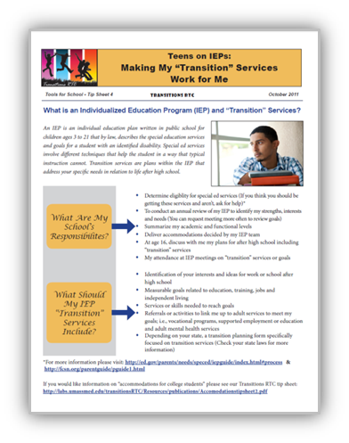
Secondary Education Intervention
Individuals with Disabilities Education Act (1997) specifies Transition Planning
High school completion among
special education students increased from 47.4% (1990) to 78.1% (2005).
This 2005 rate is similar to that of general education peers. ¹⁴
Notes:
One of the largest efforts to improve secondary education outcomes for students with serious emotional disturbance (SED) is the federal special education law, the Individuals with Disabilities Education Act (IDEA; PL 94-142). This law mandates transition planning efforts and participation of youth starting at age 16. Transition planning involves “a results-oriented process, that is focused on improving the academic and functional achievement of the child with a disability to facilitate the child’s movement from school to post schol activivtes from school to post-school activities, including post-secondary education, vocational education, integrated employment (including supported employment), continuing and adult education, “ IDEA defines emotional disturbance as follows: “…a condition exhibiting one or more of the following characteristics over a long period of time and to a marked degree that adversely affects a child’s educational performance: : (A) An inability to learn that cannot be explained by intellectual, sensory, or health factors.(B) An inability to build or maintain satisfactory interpersonal relationships with peers and teachers.(C) Inappropriate types of behavior or feelings under normal circumstances.(D) A general pervasive mood of unhappiness or depression.(E) A tendency to develop physical symptoms or fears associated with personal or school problems. Retrieved from http://nichcy.org/disability/specific/emotionaldisturbance#def

Slide 10
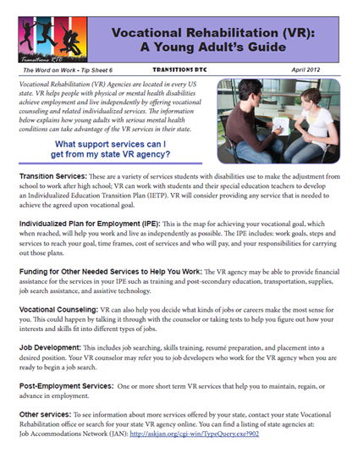
Vocational Rehabilitation
State Agencies of Vocational Rehabilitation (VR) are an important resource for improving education outcomes
  Youth ages 16- 24 account for one third of all VR clients¹⁵
  VR can support education and training in the service of a vocational goal¹⁶
  States are innovating to improve transition of high school students to VR services and employment¹⁷
  Ten percent of young adults clients with PD
  received educational support. Nearly half
  completed their VR goal. ¹⁸

Slide 11
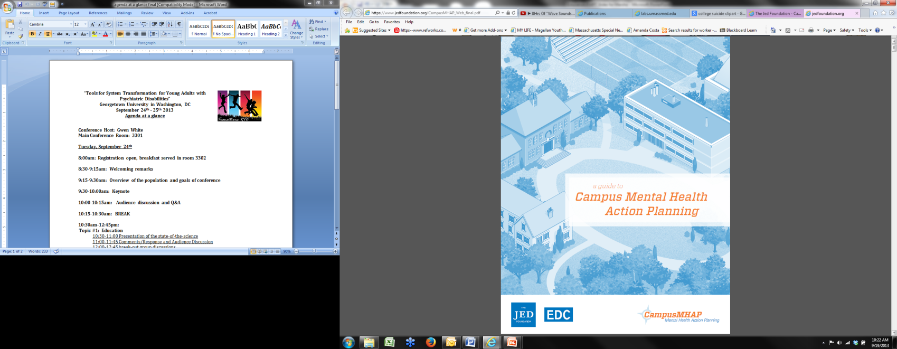
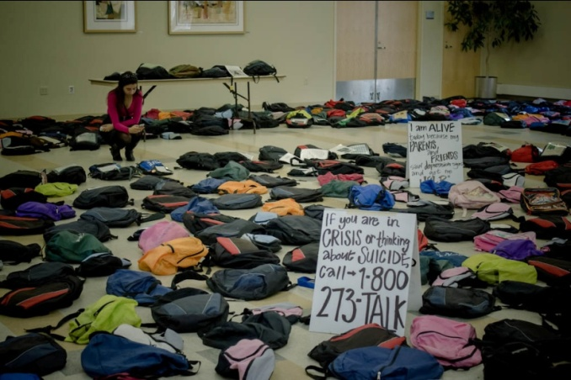
Campus Based Supports and Interventions
Environmental Supports ¹⁹
  Improve communication
  Educate the college community
  De-stigmatize mental illness
Notes:
The Social Model of Disability:
The social model of disability sees the issue of "disability" as a socially created problem and a matter of the full integration of individuals into society. In this model, disability is not an attribute of an individual, but rather a complex collection of conditions, many of which are created by the social environment. Hence, the management of the problem requires social action and is the collective responsibility of society at large to make the environmental modifications necessary for the full participation of people with disabilities in all areas of social life. The issue is both cultural and ideological, requiring individual, community, and large-scale social change

Slide 12
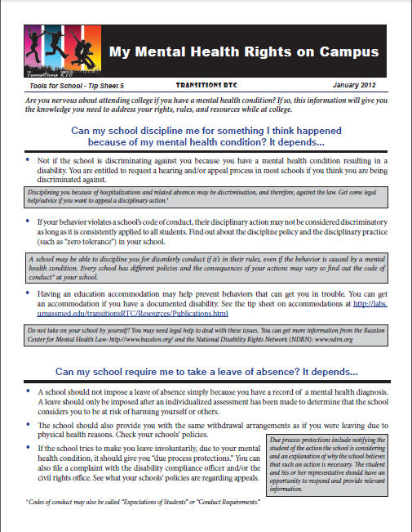
Campus Based Supports and Interventions
Changes in Policies ²⁰
  Leave of absence protocols
  Individualized re-entry requirements
  Policies for self-harm other than
  zero tolerance
  MOUs with local hospitals
Notes:
Over the past twenty years several strategies have been used by, or recommended to institutes of higher education (colleges and universities) for promoting the successful academic outcomes and retention among students with SMHC. These recommendations reflect colleges as whole communities within a larger community, such as a city or county, and therefore incorporate recommendations for policies, leadership, infrastructure, mental health literacy and support within the college community, as well as coordination with the surrounding community. The following section describes developments in these areas. However, it is important to note that these developments, to date, have undergone no rigorous testing and very limited evaluation. Thus the stage of research is best characterized as pre-scientific speaking to the need for specification of the intervention and intended population, and rigorous testing of outcomes.
Some college policies make it difficult for students with SMHC to complete their degree, such as forced absences for self-injuries or suicide attempts, or retracting student financial aid because of mental health issues (SAMHSA, 2011). Other policies can also be deleterious for students with SMHC; highly restrictive or punitive policies for withdrawals, discriminatory application of medical leave policies, and arbitrary return policies after illness (Bazelon Center for Mental Health Law, 2008). Various authors have suggested alternatives that provide a blue print for policy revisions (Bazelon Center for Mental Health Law, 2008; Gruttadaro & Crudo 2012; Smith, Ackerman, & Costa, 2011), including:
Leave-of-absence protocols
Policies for self-harm other than zero tolerance
Individualized re-entry requirements
Protocols that encourages campus wide, multi departmental communication about a student in distress.
An emergency contact notification protocol where students are encouraged to sign release of information allowing notifications under specified circumstances
Memoranda of understanding with a local hospital for students in psychiatric crises

Slide 13
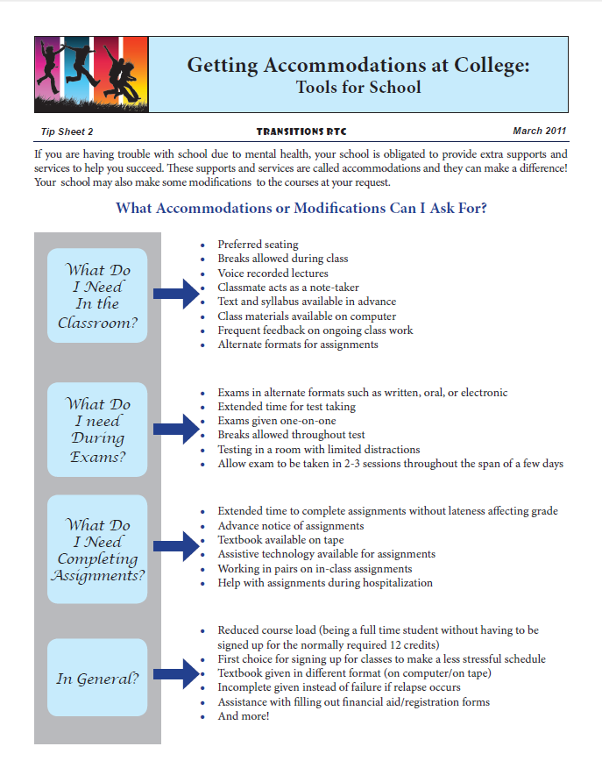
Campus Based Supports and Interventions
Educational Accommodations ²¹
  Students are unaware of
  rights or fear disclosure
  Disability staff don’t know
  how to accommodate PD
Notes:
Accommodations are "any change in the work environment [or instructional setting] or in the way things are customarily done that enables an individual with a disability to enjoy equal opportunities" (Costa, 2011). Similar to employment, reasonable accommodations are available for students with a qualifying disability by the Americans with Disabilities Act and later amendments (Souma et al., 2006). The types of educational accommodations used by students with SMHC accommodations include: extended time to complete assignments and tests, private feedback, and use of tape recorders in class (Salzer et al., 2008). Surveys have shown increasing awareness and use of educational accommodations over time among students with SMHC and use of accommodations are associated with better student outcomes (Salzer et al., 2008; Gruttadaro & Crudo, 2012). Barriers to accommodations use include;
Lack of awareness of accommodations or their rights to receive them (Collins & Mowbray, 2008; Dobmeier et al., 2011; Salzer et al., 2008)
Fear of the consequences of disclosing their condition (mtvU, 2006; Salzer et al., 2008)
Student disability offices that are ill-prepared to handle requests from students with SMHC (Collins & Mowbray, 2005; Collins & Mowbray, 2008)
The “hidden” and episodic nature of psychiatric disabilities contributing to the need for creative and thoughtful assessment.
Research on student disability office practices suggests that the following practices are associated with higher enrollment of students with SMHC: staff in the office with a specific qualification in psychiatric disability, referrals to the office coming from student services, a specific and larger office, and access and knowledge of supported education services (Collins & Mowbray, 2008).

Slide 14
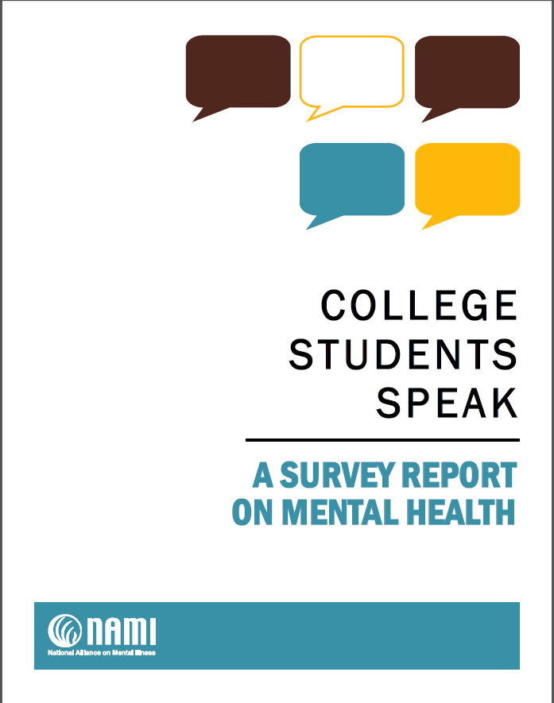
Campus Based Supports and Interventions
  Campus Mental Health Counseling
  Peer Support
  Suicide Prevention
Notes:
The number and severity of problems among students seeking help from campus counseling centers are rising (Mowbray et al., 2006, Gallagher, 2012). Challenges that campus counseling centers face in addressing these emerging needs include: deficiencies in accessibility, issues related to confidentiality, emergency response capability, staff training in young adult development, and resistance from administrators to these centers embracing a truly therapeutic treatment role (Mowbray et al., 2006).
Several improvements for college counseling services have either been made (noted with a * from Gallagher, 2012) or recommended including:
Making services easier to obtain (Watkins et al., 2012)
Greater accessibility ( such as weekend and evening hours)( Watkins et al., 2012)
Using qualified mental health staff (not graduate students) (Watkins et al., 2012)
Providing an on-call psychiatrist (Watkins et al., 2012)
Better crisis management and prevention procedures/ earlier identification*
Aggressive outreach (Watkins et al., 2012)
Anonymous online screening tools to enable campus mental health clinicians to reach out to students exhibiting warning signs (Watkins et al., 2012)
Communication campaigns as described above under campus culture (Watkins et al., 2012)
Peer counseling or peer education programs to take advantage of students’ willingness to talk to peers (Watkins et al., 2012)
Providing 24/7 crisis teams or hotlines (Gruttadaro & Crudo, 2012)
Training, as described under Campus culture, especially around suicide issues (Watkins et al., 2012)
Providing a complete diagnostic, psychosocial and functional assessment (Watkins et al., 2012)
Providing seamless referrals to student health and disability services (Mowbray et al., 2006)
More long–term services and expanded external referral networks*
Improved coordination and follow-up with referrals to community based treatment, (Watkins et al., 2012)
Behavioral intervention team that meet to discuss students at risk or of concern (Gruttadaro & Crudo, 2012)
Skills training for students to help them learn to tolerate and manage mild to moderate emotional discomfort without medication*
Adjustments for changing student demographics*

Slide 15
Supported Education-Definitions
Services that enable a person to choose an educational goal, pursue activities needed to achieve that goal, then maintain those activities until goal achievement (Choose, Get, Keep)
Interventions that support and assist to access, enroll, retain and succeed in postsecondary education
Interventions that provides assistance, preparation, and support for enrollment in, and completion of, postsecondary educational programs.
Interventions designed to assist individuals in making choices about education and training and to assist them in maintaining their “student status” until their educational goal is achieved ^{22,23}

Slide 16
Key Components²⁴
  Coordination with mental health services
  Use of specialized SEd staff
  Career/vocational counseling
  Help with financial aid
  Help to develop skills to cope in academic settings
  On campus information about rights/resources
  Off campus mentorship and support
  Access to academic supports
  Access to general supports

Slide 17
Supported Education-Models
Classroom model -classes on campus for information and support
Onsite model -individual support provided by educational institution
Mobile support -support and services through a MH agency
Free-standing model -support through other organizations such as clubhouses

Slide 18
Values of Supported Education
Similar to the values of supported employment and rehabilitation in general
    Integrated educational settings
    Choice and self-determination
    Provision of supports as needed and wanted
    Focus on skill development rather than on symptoms/diagnosis/pathology alone

Slide 19
SEd—State of the Field
SEd developed/tested mostly with adults who have serious mental illness through MH agencies
Some models involve Offices of Disability Services on campuses
Models not tested with young adults and may need to be adapted
While values of SEd may be same across lifespan, the issues confronting young adults may vary
Means of communicating information and supporting young adults may also be different

Slide 20
Effectiveness of Supported Education-
Systematic review–1990-2010; updated in 2013²⁵
Writings on the principles and processes of providing supported education
Found 41 articles; 21 reviewed for research quality
Very limited number of rigorous studies
Simple pre post studies; descriptions of models
One large RCT in the literature
Two new fidelity measures are available^{26,27}, but could not locate research studies utilizing fidelity assessments

Slide 21
Outcomes Generally Examined in SEd
Educational engagement
Enrollment in educational setting
Educational attainment (components completed, acquisition of degree)
Employment outcomes
Subjective measures such as self esteem/mastery
Quality of life

Slide 22
Effectiveness of SEd
No evidence from a randomized trial or well controlled quasi experimental trial that participation in a supported education intervention results in significantly greater educational engagement or enrollment
No significant difference in the employment rates at follow-up of individuals participating in a supported education intervention versus those not participating

Slide 23
Effectiveness of SEd
Suggestive evidence of improvements in employment and educational status as a result of participation in a supported education intervention
Self esteem/quality of life may improve
Individuals who remain engaged in SEd may complete courses and achieve satisfactory GPA
Evidence is weak

Slide 24
Conclusions
Several studies suggest that SEd is a viable model
Improvements in educational status and attainment suggestive, but studies weak and older
Therefore: not enough evidence to say that there is robust effectiveness data for SEd models

Slide 25
Promise on Horizon
Nuechterlein-recent onset schizophrenia-career development intervention based on SE-IPS model²⁸
RAISE study—multisite NIMH study focusing on young adults
Salzer/Gill/Mullen -2013 RCT underway but effectiveness data not yet available
Center for Psychiatric Rehabilitation has an exploratory study combining supported education component with supported employment-no preliminary data
Two preliminary studies done in OT field—Australia and NYC--BRIDGE

Slide 26
Lessons Learned-Landscape of Supports
Policy innovation in special education has been beneficial—but we don’t know why it is effective
Young adults with SMHC lag behind general population in educational attainment
College campuses seem unprepared to assist with challenges of SMHC population
Literature includes support strategies but few are tested

Slide 27
Lessons Learned
Adaptations of existing models for young adults is needed
Further adaptation and innovation is needed for special populations such as those involved in foster care or the criminal justice system
No data currently exist that speak to long term outcomes of SEd

Slide 28
Next steps for research—we need:
Additional data about barriers and facilitators to educational attainment—from perspective of young adults with SHMC
Innovation, adaptation, refinement of models of SEd
Specification and rigorous testing of SEd models
Rigorous evaluation of models that focus on young adults with SMHC on campus

Slide 29
References
United States Department of Labor. (2010). Employment projections: Education pays in higher earnings and lower unemployment rates. (Bureau of Labor Statistics).U.S. Government Printing Office. Retrieved from http://www.bls.gov/emp/ep_chart_001.htm
Souma, A., Rickerson, N., & Burgstahler, S. (2006). Academic accommodations for students with psychiatric disabilities DO-IT, University of Washington.
U.S. Department of Education, (2009). Office of Special Education and Rehabilitative Services, Office of Special Education Programs, 28th Annual Report to Congress on the Implementation of the Individuals with Disabilities Education Act, 2006, vol. 1, Washington, D.C., 2009.
Forness, S. R., Freeman, S. F., Paparella, T., Kauffman, J. M., & Walker, H. M. (2012). Special education implications of point and cumulative prevalence for children with emotional or behavioral disorders. Journal of Emotional and Behavioral Disorders, 20(1), 4-18.
Wagner, M., & Newman, L. (2012). Longitudinal transition outcomes of youth with emotional disturbances. Psychiatric Rehabilitation Journal, 35(3), 199-208.
U.S. Department of Education. (2004). Twenty-sixth annual report to congress on the implementation of the individuals with disabilities education act. Washington, D.C.
Sharpe, M. N., & Bruininks, B. D. (2003). Services for students with psychiatric disabilities in the big ten schools. (Unpublished manuscript).University of Minnesota.
Neumann University. (2013). National data on campus suicide and depression. Retrieved
4/2013, from
http://www.neumann.edu/life/counseling/mental_health/suicide/national_data.htm

Slide 30
References
Newman, L., Wagner, M., Knokey, A., Marder, C., Nagle, K., Shaver, D., & Wei, X. (2011). The post-high school outcomes of young adults with disabilities up to 8 years after high school: A report from the national longitudinal transition study-2 (NLTS2). NCSER 2011-3005. National Center for Special Education Research. Menlo Park, CA: SRI International.
Kessler, R. C., Foster, C. L., Saunders, W. B., & Stang, P. E. (1995). Social consequences of psychiatric disorders, I: Educational attainment. American Journal of Psychiatry, 152(7), 1026-1032.
Newman, L., Wagner, M., Knokey, A., Marder, C., Nagle, K., Shaver, D., & Wei, X. (2011). The post-high school outcomes of young adults with disabilities up to 8 years after high school: A report from the national longitudinal transition study-2 (NLTS2). NCSER 2011-3005. National Center for Special Education Research. Menlo Park, CA: SRI International.
Eisenberg, D., Golberstein, E., & Gollust, S. E. (2007). Help-seeking and access to mental health care in a university student population. Medical Care, 45(7), 594-601.
Salzer, M. S. (2012). A comparative study of campus experiences of college students with mental illnesses versus a general college sample. Journal of American College Health, 60(1), 1-7.
Wagner, M., & Newman, L. (2012). Longitudinal transition outcomes of youth with emotional disturbances. Psychiatric Rehabilitation Journal, 35(3), 199-208.
Honeycutt, T., Thompkins, A., Bardos, M., & Stern, S. (2013). State Differences in the Vocational
Rehabilitation Experiences of Transition-Age Youth with Disabilities (No 7873).
Washington DC: Mathematica Policy Research.

Slide 31
References
Whitney, J., Smith, L. M., & Duperoy, T. (2012). Vocational rehabilitation (VR): A young adults guide. The Word on Work (Tip Sheet No. 6). Worcester, MA: University of Massachusetts
Andrea Guest. Personal Communication. Council on State Agencies of Vocational Rehabilitation, Transition Committee.
Frank Smith. Personal Communication. Analysis of Vocational Rehabilitation State Agency Data, Institute for Community Inclusion, Boston, MA
The Jed Foundation. Campus Mental Health Action Planning. Retrieved September 2013 from https://www.jedfoundation.org/professionals/programs-and-research/campusmhap
Smith, L. M., Ackerman, N., & Costa, A. (2011). My Mental Health Rights on Campus. Tools for School. Tip Sheet # 5. Worcester, MA: University of Massachusetts Medical School, Department of Psychiatry, Center for Mental Health Services Research, Transitions Research and Training Center
Costa, A. (2011). Getting accommodations at college: Tools for school. (Tip Sheet No. 2).Worcester, MA: University of Massachusetts Medical School, Department of Psychiatry, Center for Mental Health Services Research, Transitions RTC.
Collins, M. E., & Mowbray, C. T. (2008). Students with psychiatric disabilities on campus: Examining predictors of enrollment with disability support services. Journal of Postsecondary Education and Disability, 21(2), 91-104.

Slide 32
References
Soydan, A. S. (2004). Supported education: A portrait of a psychiatric rehabilitation intervention. American Journal of Psychiatric Rehabilitation, 7(3), 227-248.
Waghorn, G., Still, M., Chant, D., & Whiteford, H. (2004). Specialised supported education for Australians with psychotic disorders. Australian Journal of Social Issues, 39(4), 443.
Rogers, E. S., Kash-Macdonald, M., Bruker, D., & Maru, M. (2010). Systematic review of supported education literature, 1989-2009. Boston, MA: Boston University, Sargent College, Center for Psychiatric Rehabilitation.
Manthey, T.J., Coffman, M., Goscha, R., Bond, G., Mabry, A., Carlson, L., Davis, J., & Rapp, C. (2012). The University of Kansas Supported Education Toolkit 3.0. Lawrence, Kansas: Office of Mental Health Research and Training, University of Kansas, School of Social Welfare.
Unger, K. (2009). Key elements of supported education. Retrieved August 29th, 2013, from http://www.supportededucation.com/elements.html
Nuechterlein, K. H., Subotnik, K. L., Turner, L. R., Ventura, J., Becker, D. R., & Drake, R. E. (2008). Individual placement and support for individuals with recent-onset schizophrenia: Integrating supported education and supported employment. Psychiatric Rehabilitation Journal, 31(4), 340-349.

