Slide 1
XR Ideation and Pilots for Medical Education via Community Engagement and Internships
June 2, 2022 | 2022 Information Technology in Academic Medicine Conference
New York, NY

Slide 2
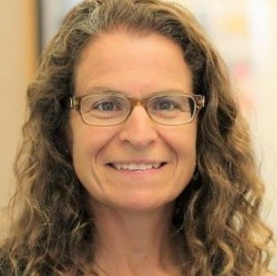
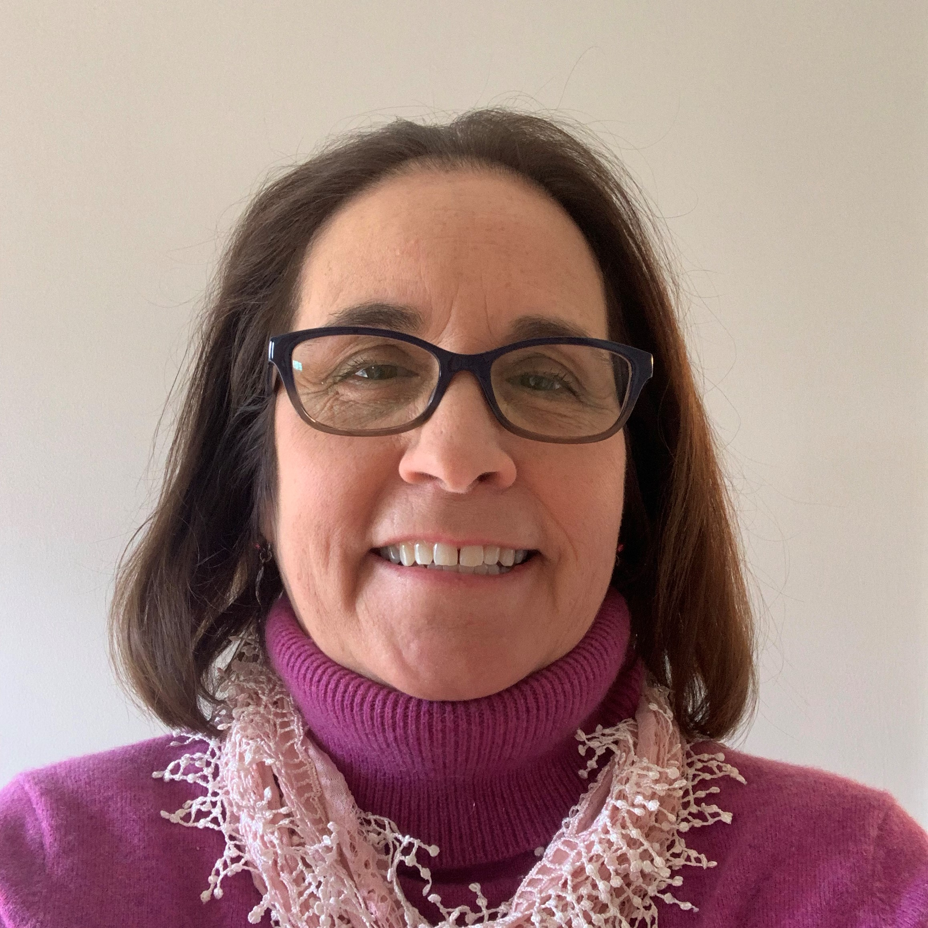
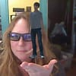
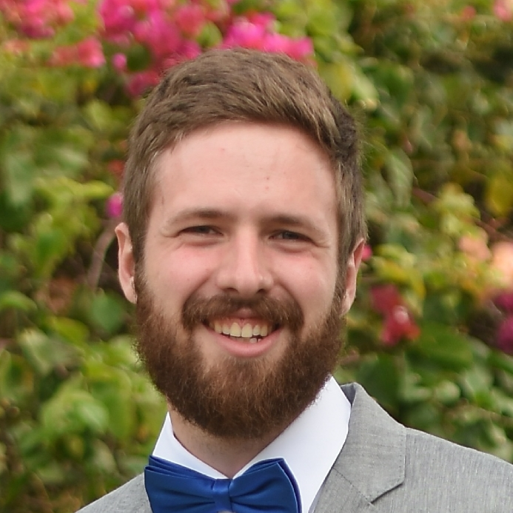
The UMass Chan MedXR Team
Melissa Fischer, MD MEd
Professor of Medicine
Assistant Vice Provost, Interprofessional & Instructional Innovation
Executive Director, interprofessional Center for Experiential Learning & Simulation (iCELS)
Patty Lanzillotti
Associate CIO,
Academic Technology
Information Technology
Julie LeMoine
Asst Professor
Neurobehavioral Technology
Irish Research Council Scholar
PhD candidate in Applied XR
Co-founder of MedVR
Matt Kersey
Academic Augmented and Virtual Reality Intern
MS student in Computer Science at Columbia University

Slide 3
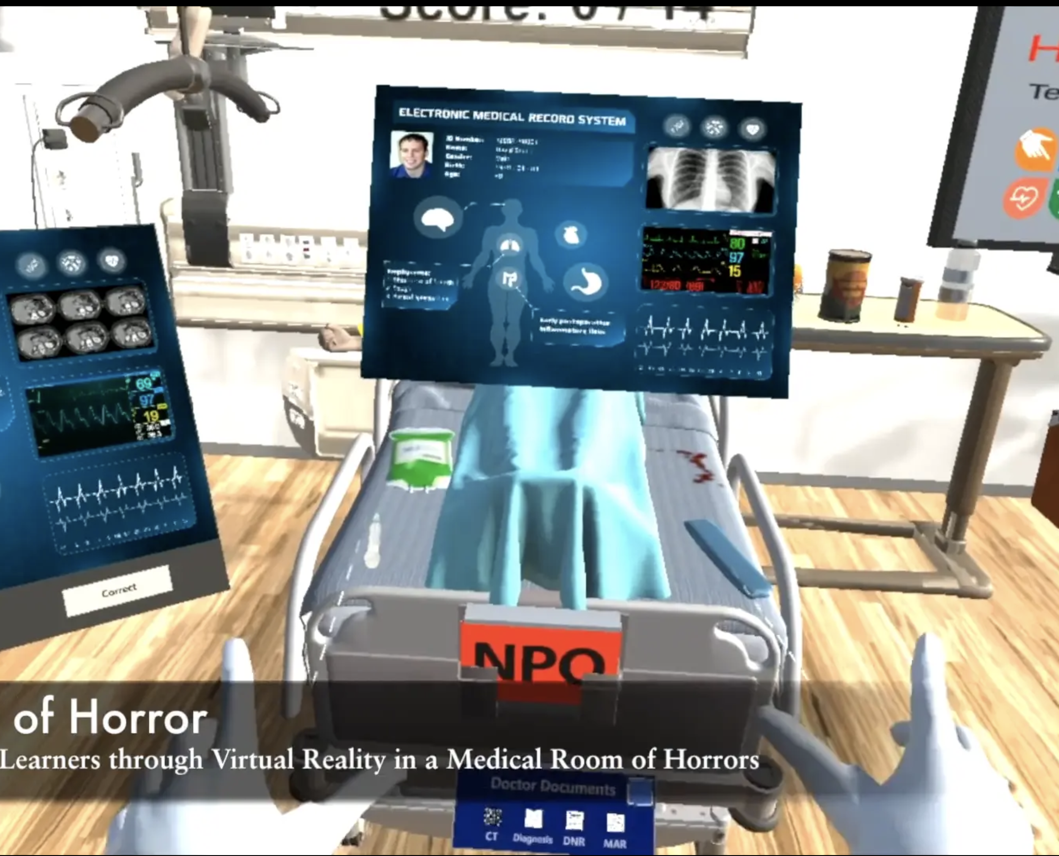
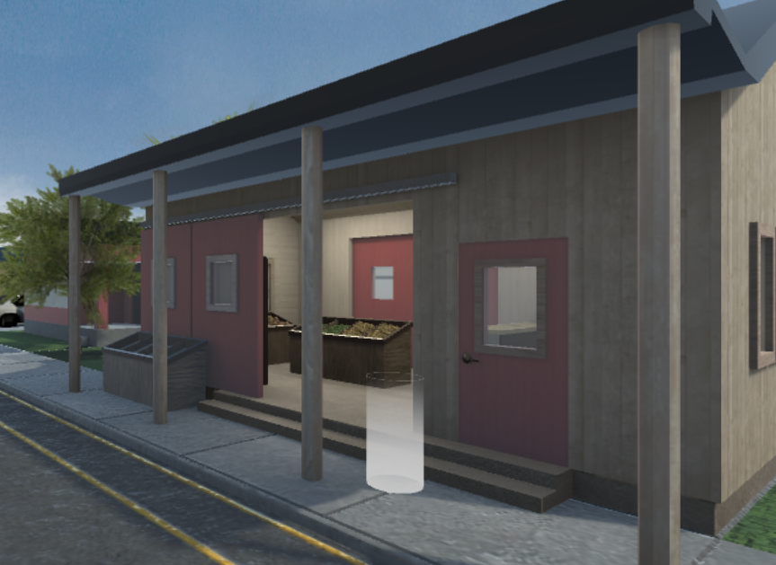
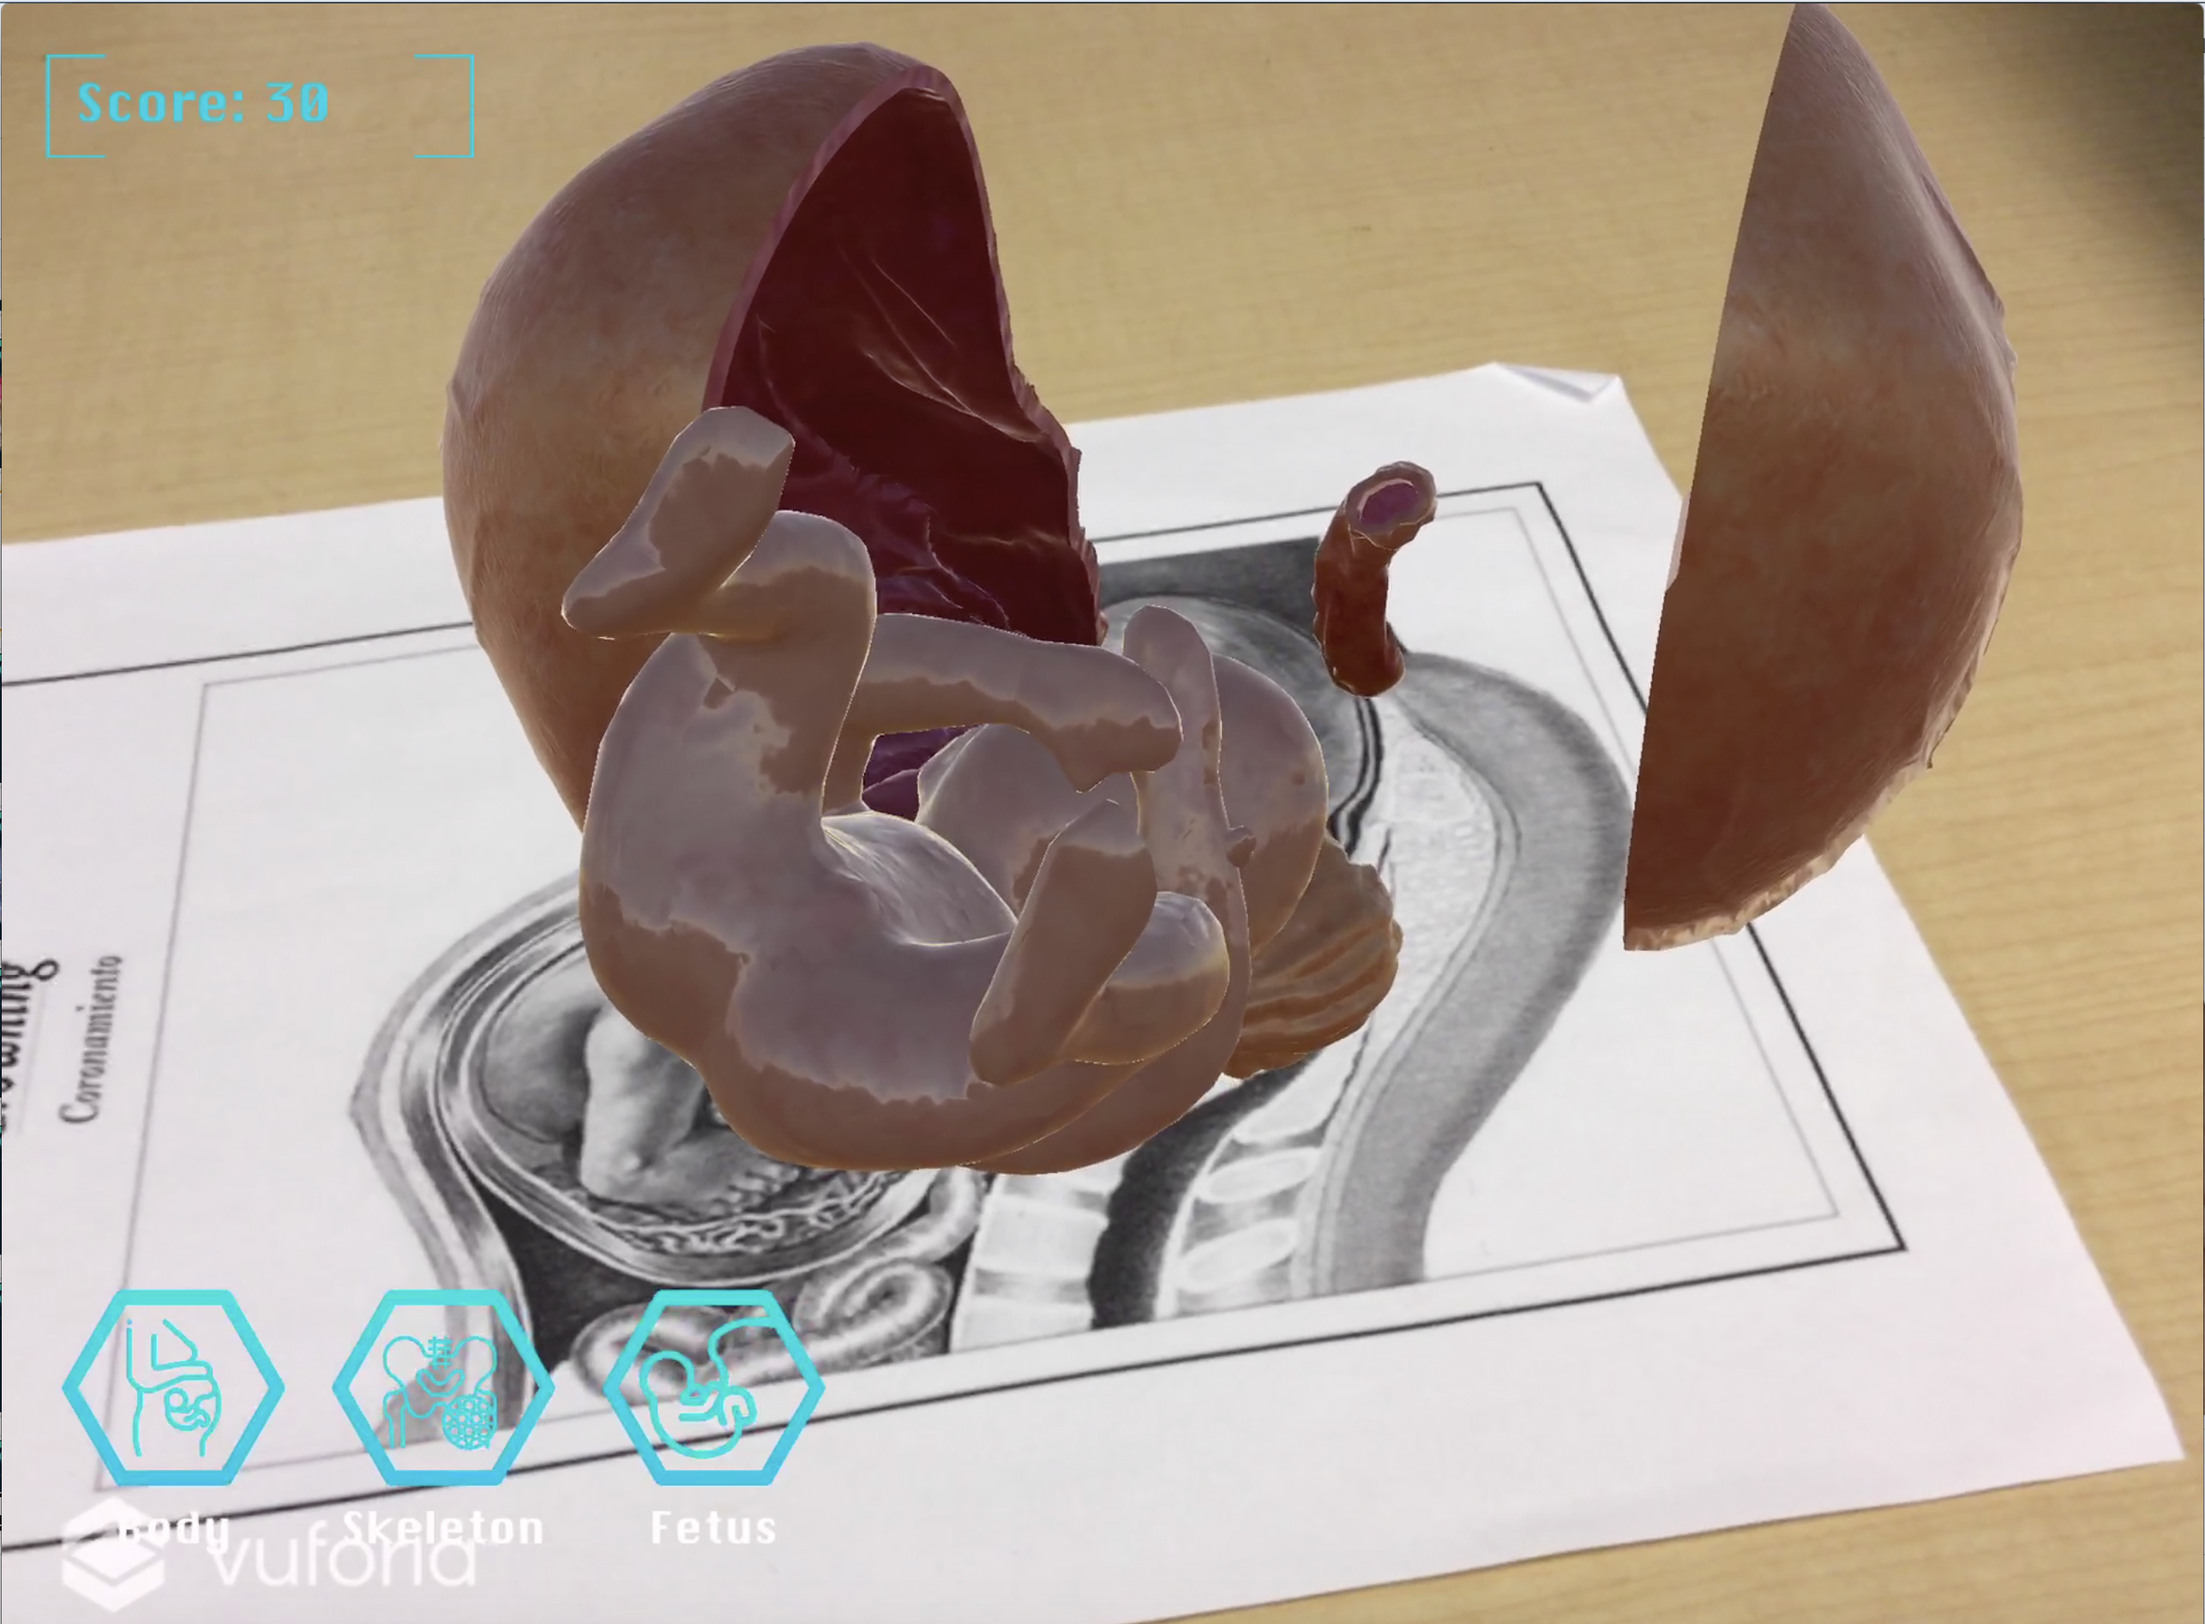
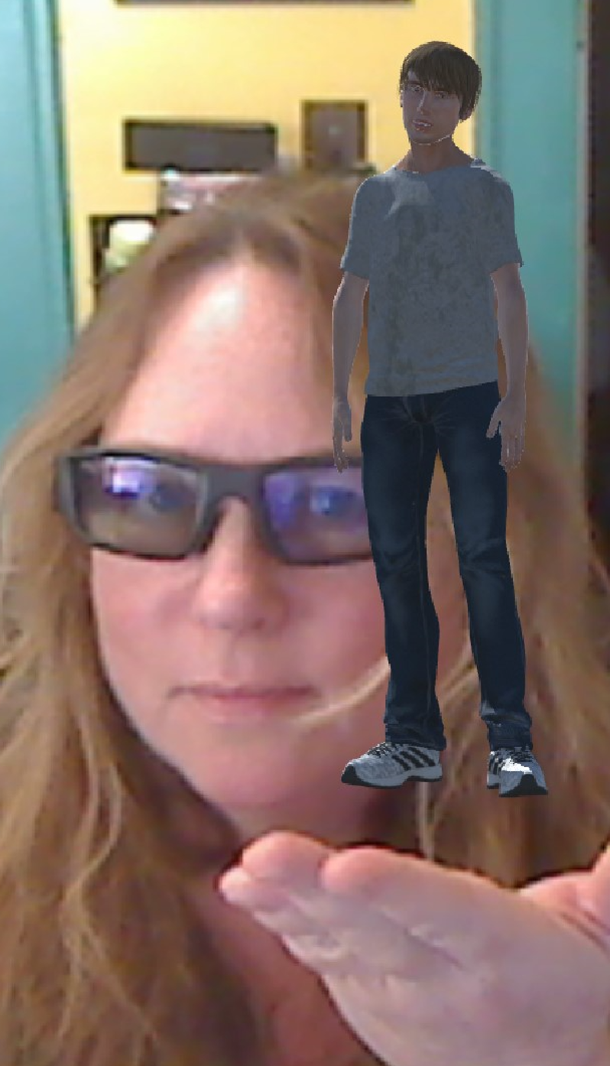
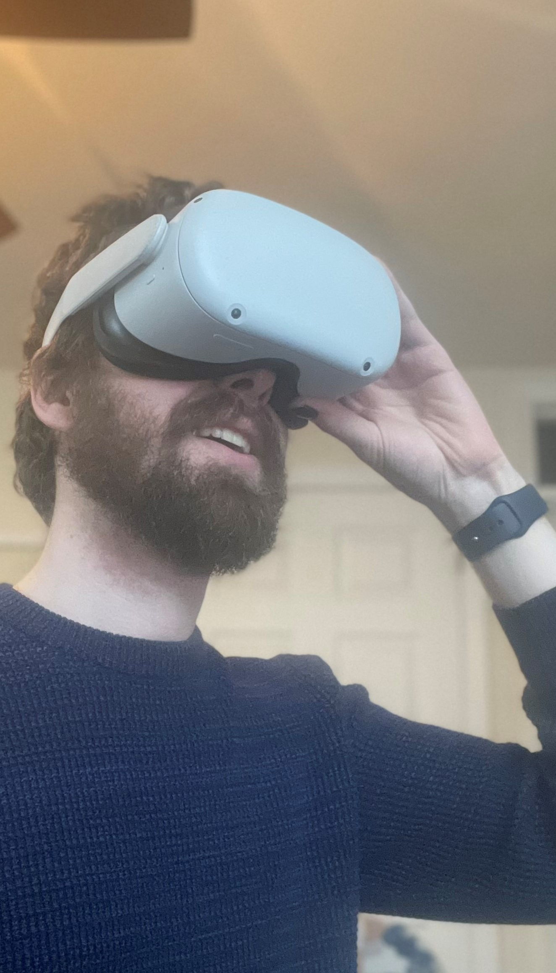
What is XR?

Slide 4
Virtual Reality
Fully immersive
Virtual content in a virtual space
Headsets
An example of a VR simulation

Slide 5
Augmented Reality
Virtual content in the real world
Smartphones, tablets, headsets
An example of an AR application

Slide 6
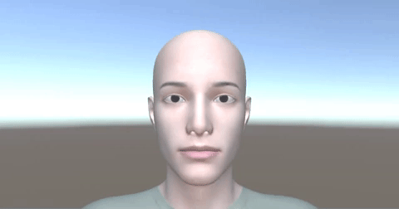
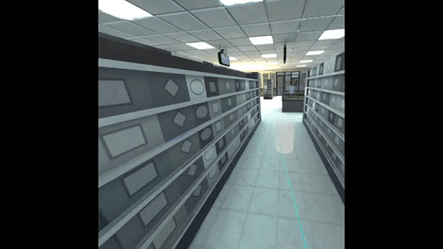
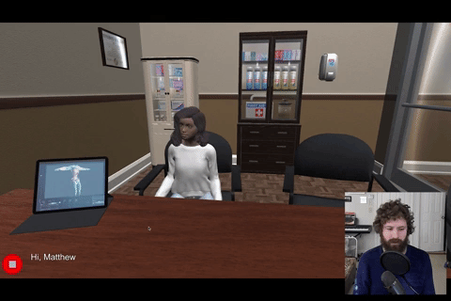
XR has many possible medical applications
Practicing communicating with patients on desktop
Augmenting
standardized patients with facial droop using AR
Learning about
social determinants
of health in VR

Slide 7


UMass Chan’s ideology of IT internships
UMass Chan
  Talented individuals from diverse backgrounds matched with unique technology opportunities
    Supports early stages of program development
    Fosters innovation, passion, and creativity
    Provides opportunities for networking and mentoring
    Furthers the mission of the University
    Gains fresh perspective from students
    Enhances student experience and learning
New opportunity
Fresh perspectives
Student Interns

Slide 8
MedXR is enriched through development and community engagement
Interprofessional Center for Experiential Learning & Simulation (iCELS)
Associate Dean for Undergraduate
Medical Education
IT
ACIO, Academic Technology
XR Intern
MedXR
Internship program
Weekly outreach cafes
Community-driven projects
Eunice Kennedy
Shriver Center
XR Expert, Asst. Professor
Community
Subject Matter & Lived Experience Experts
Notes:
Faculty and community members provide domain knowledge about medicine and places where XR, or other technologies, could be used
Suggest areas where technology can augment medical education
Partner with intern and students throughout development lifecycle
Students provide insight into how applications can best serve them
Students actively participate in testing the concepts and provide feedback

Slide 9
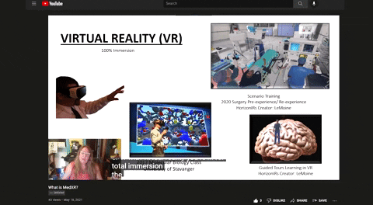
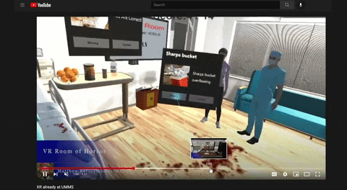
Intern skills + community expertise = valuable ideation
Educated community about XR
  - Seeded emphasis on diverse populations, technologies, and institutional priorities
Community submitted ideas
Rated submissions
Selected top three

Slide 10
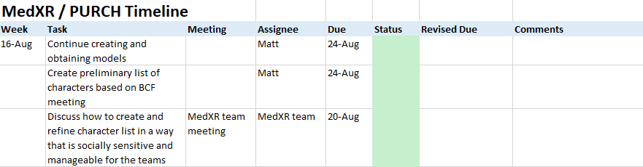
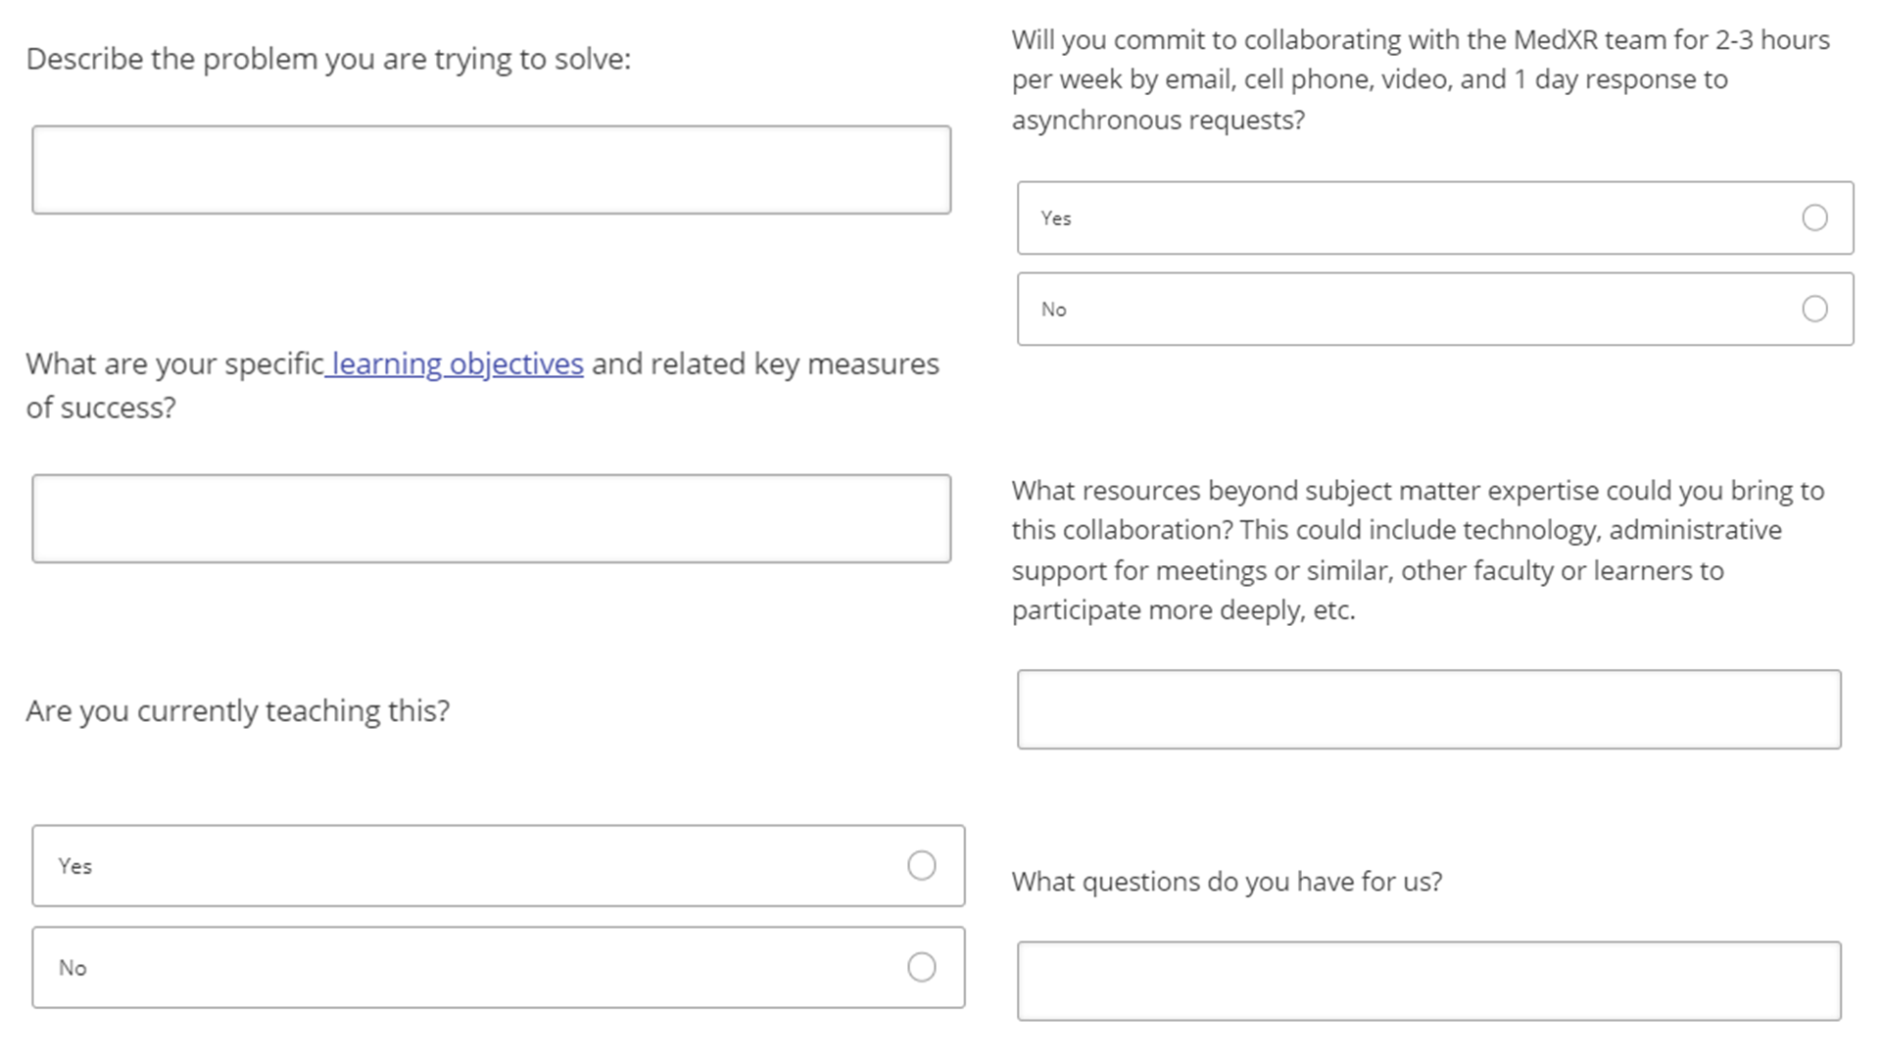
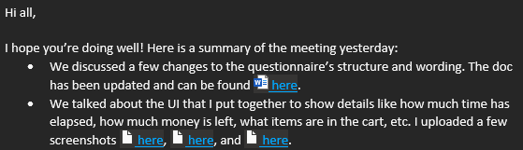
Multi-modal tools maintain engagement & productive collaboration

Slide 11
Pitching an internship
& building an ideation campaign

Slide 12
Creating XR Experiences

Slide 13





Creating XR Experiences
Pipeline
Define
Storyboard, Scripts, & Engagement Plan
Create
Procure
Record
Model
Animate
Tools
Establish
Game Engines
SW dev.
3rd Party Libs, APIs, etc.
Deploy
Displays
Apps/Viewers
Services
Platforms, Hosting

Slide 14






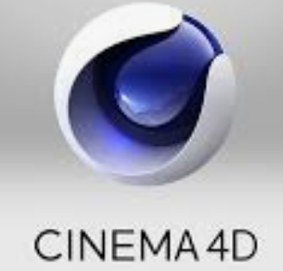





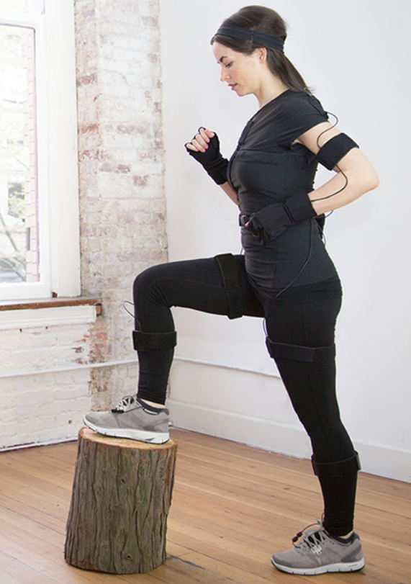



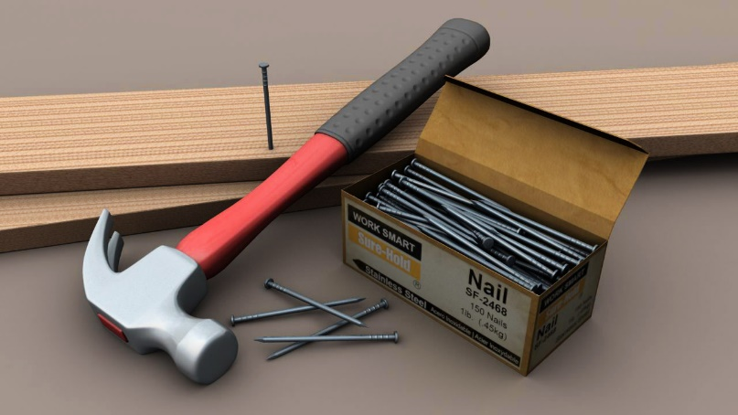










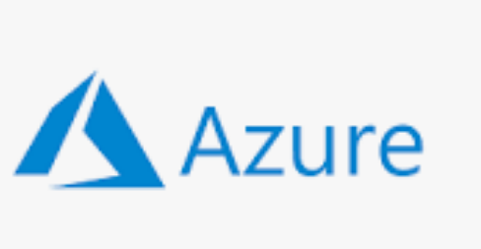



Creating XR Experiences
Pipeline
Define
Storyboard, Scripts, & Engagement Plan
Create
Procure
Record
Model
Animate
Tools
Establish
Game Engines
SW dev.
3rd Party Libs, APIs, etc.
Deploy
Displays
Apps/Viewers
Services
Platforms, Hosting
C#

Slide 15



Creating XR Experiences
Pipeline
Define
Storyboard, Scripts, & Engagement Plan
Create
Procure
Record
Model
Animate
Tools
Establish
Game Engines
SW dev.
3rd Party Libs, APIs, etc.
Deploy
Displays
Apps/Viewers
Services
Platforms, Hosting
Talent
C#

Slide 16
Creating XR Experiences
Pipeline
Define
Storyboard, Scripts, & Engagement Plan
Create
Procure
Record
Model
Animate
Tools
Establish
Game Engines
SW dev.
3rd Party Libs, APIs, etc.
Deploy
Displays
Apps/Viewers
Services
Platforms, Hosting
Talent
C#

Slide 17
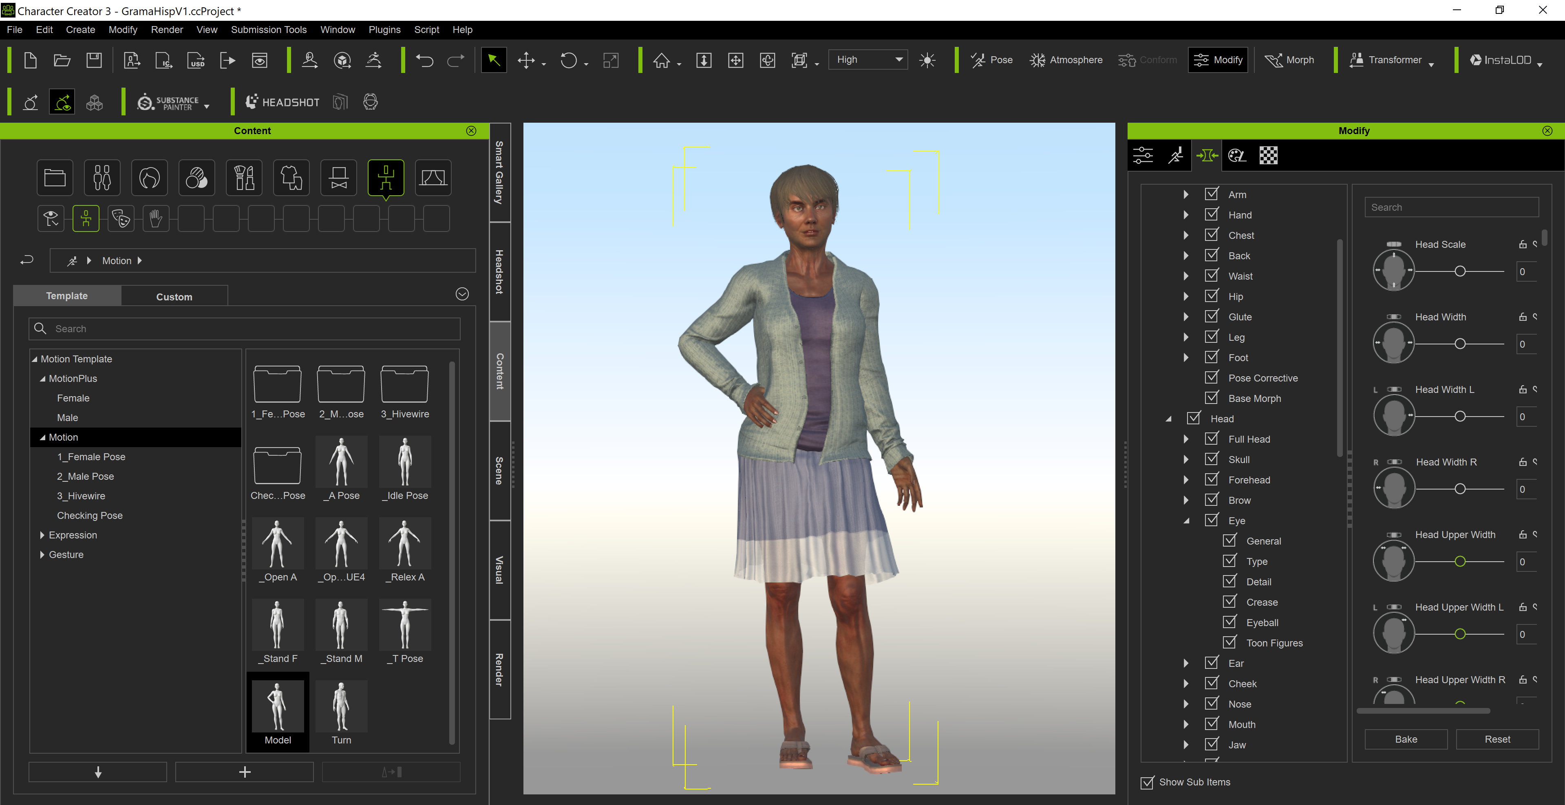
Character Creation
Character
Creation

Slide 18
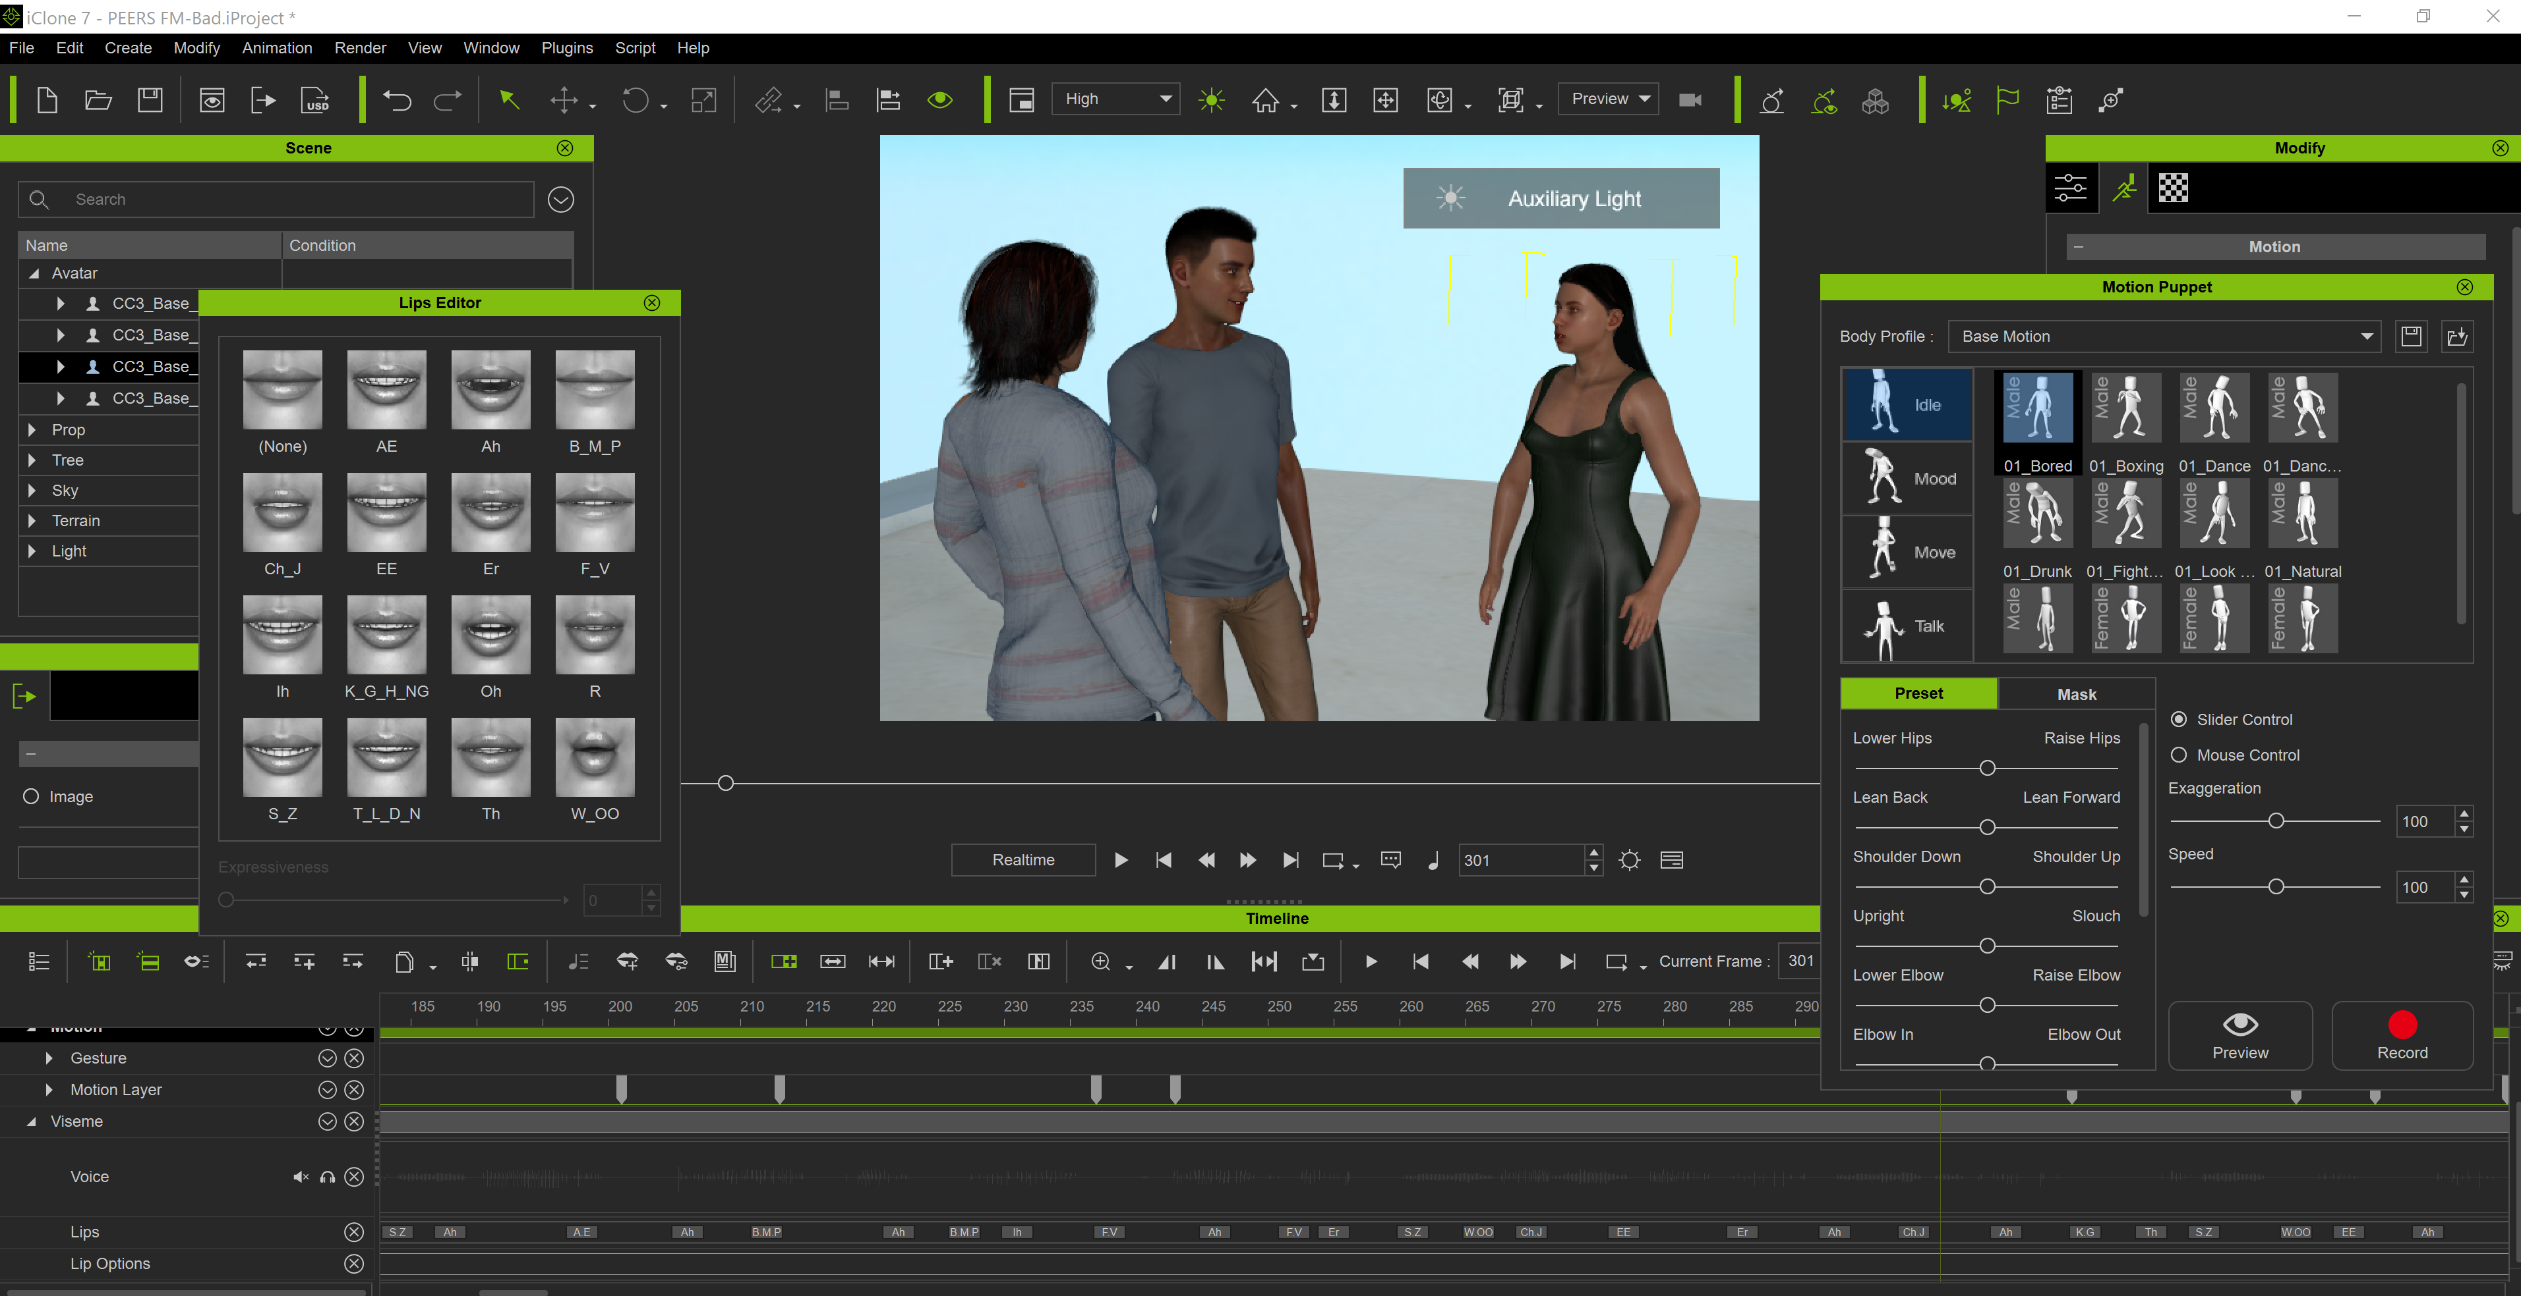
Animation

Slide 19
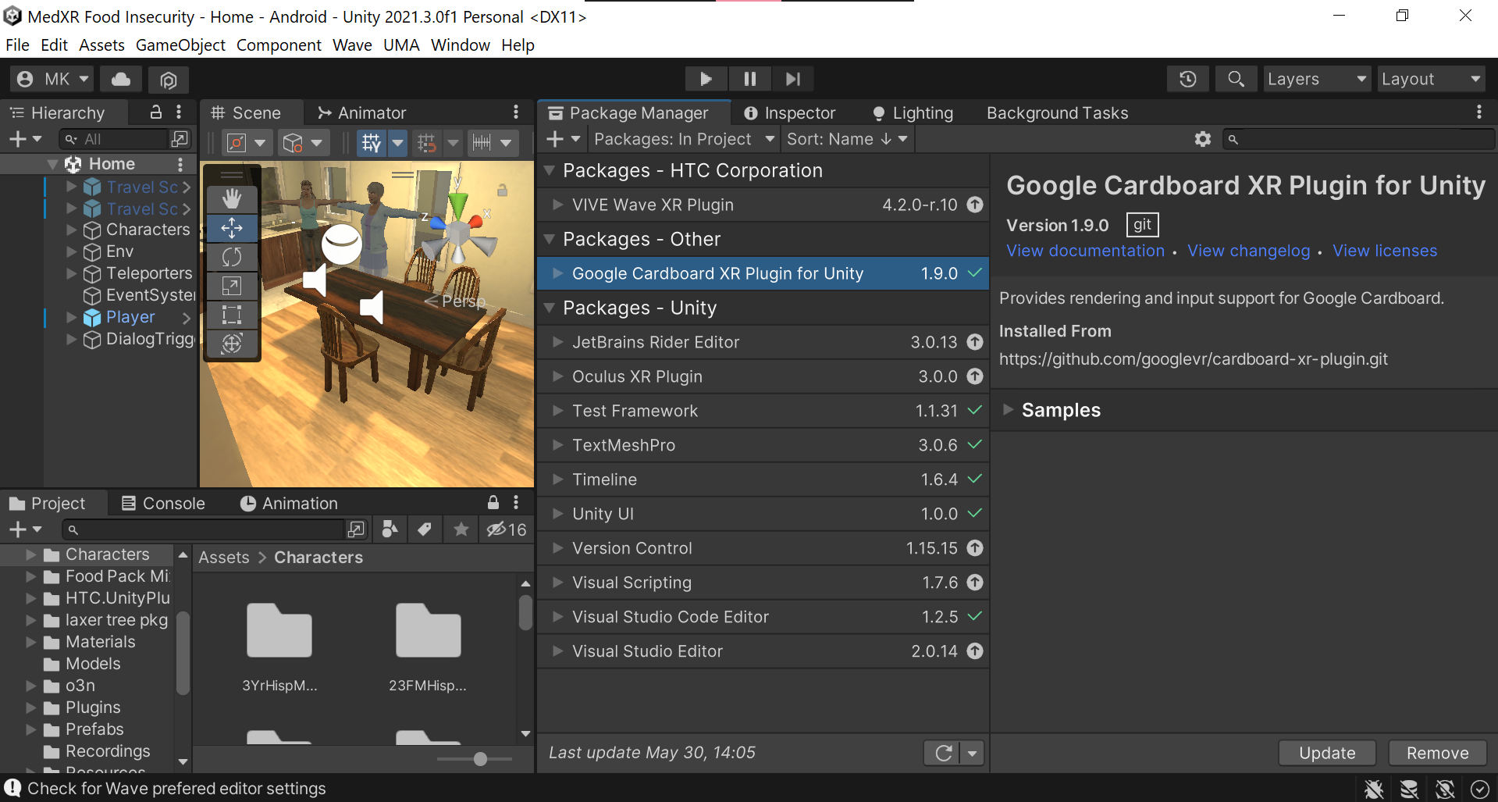
Game
Engine Project

Slide 20
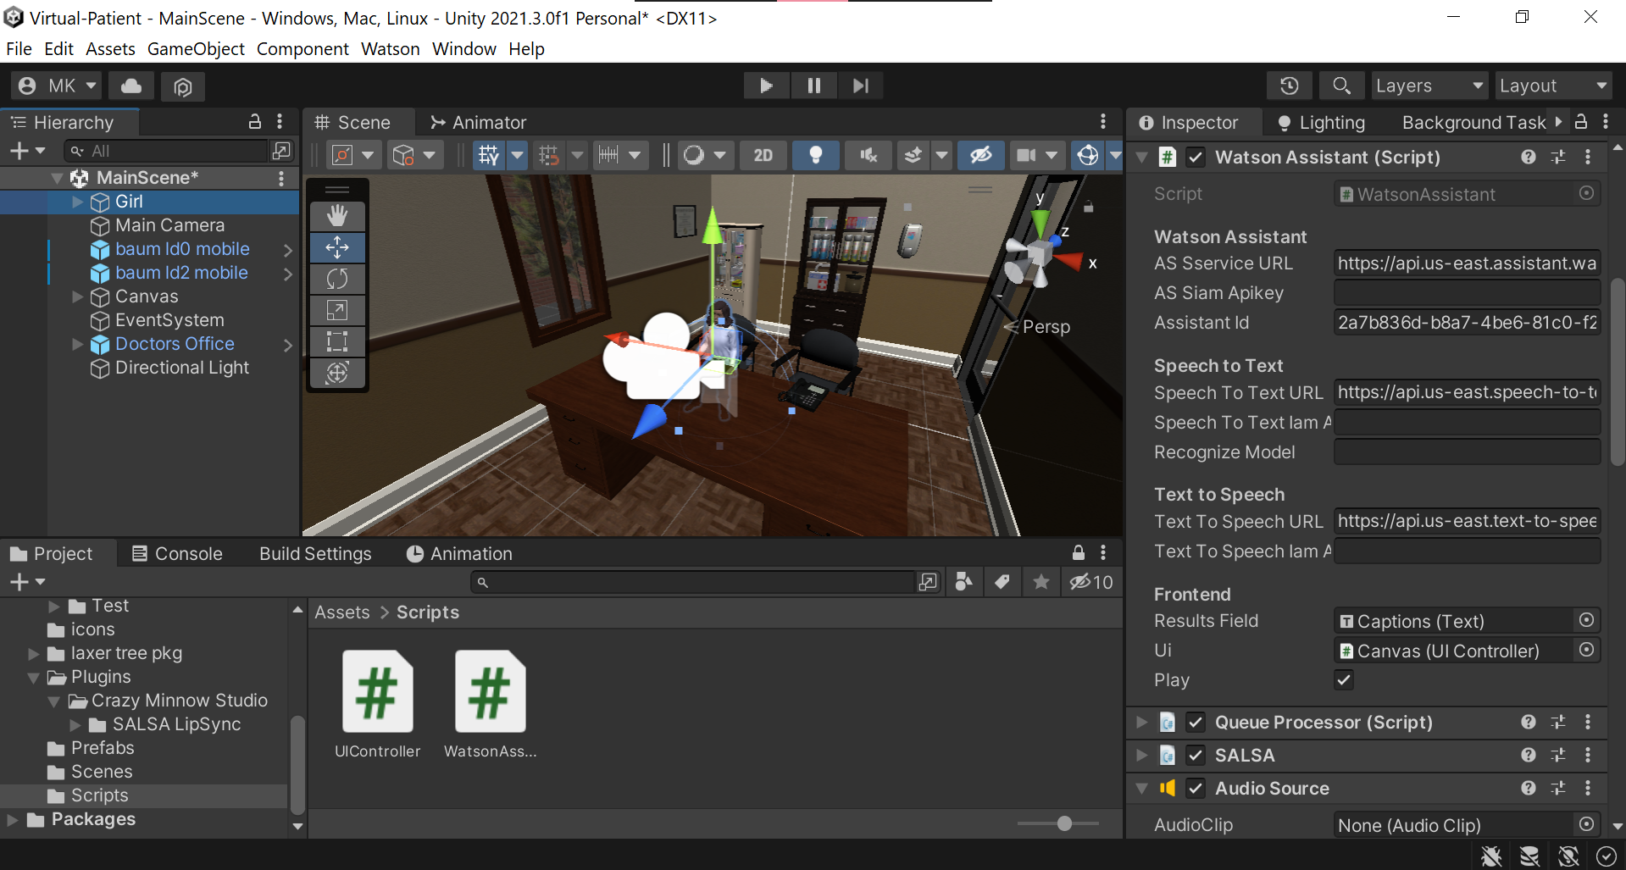
Game
Engine Project

Slide 21
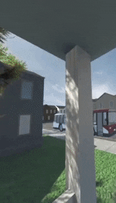
XR will power curriculum innovation
Key takeaways
High impact: pairing interns with experts
Organization: management and documents
XR tools: democratized and require expertise

Slide 22
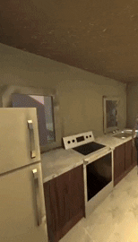
XR development can be challenging
Maintaining engagement
Complex, lots of moving parts
Public perception and responsible use

Slide 23
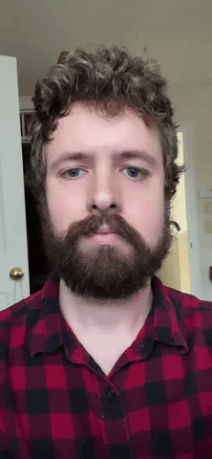
Valuable results
Context-specific VR: food insecurity
Enhanced manikin-based visual fidelity
Virtual adolescent communication

Slide 24
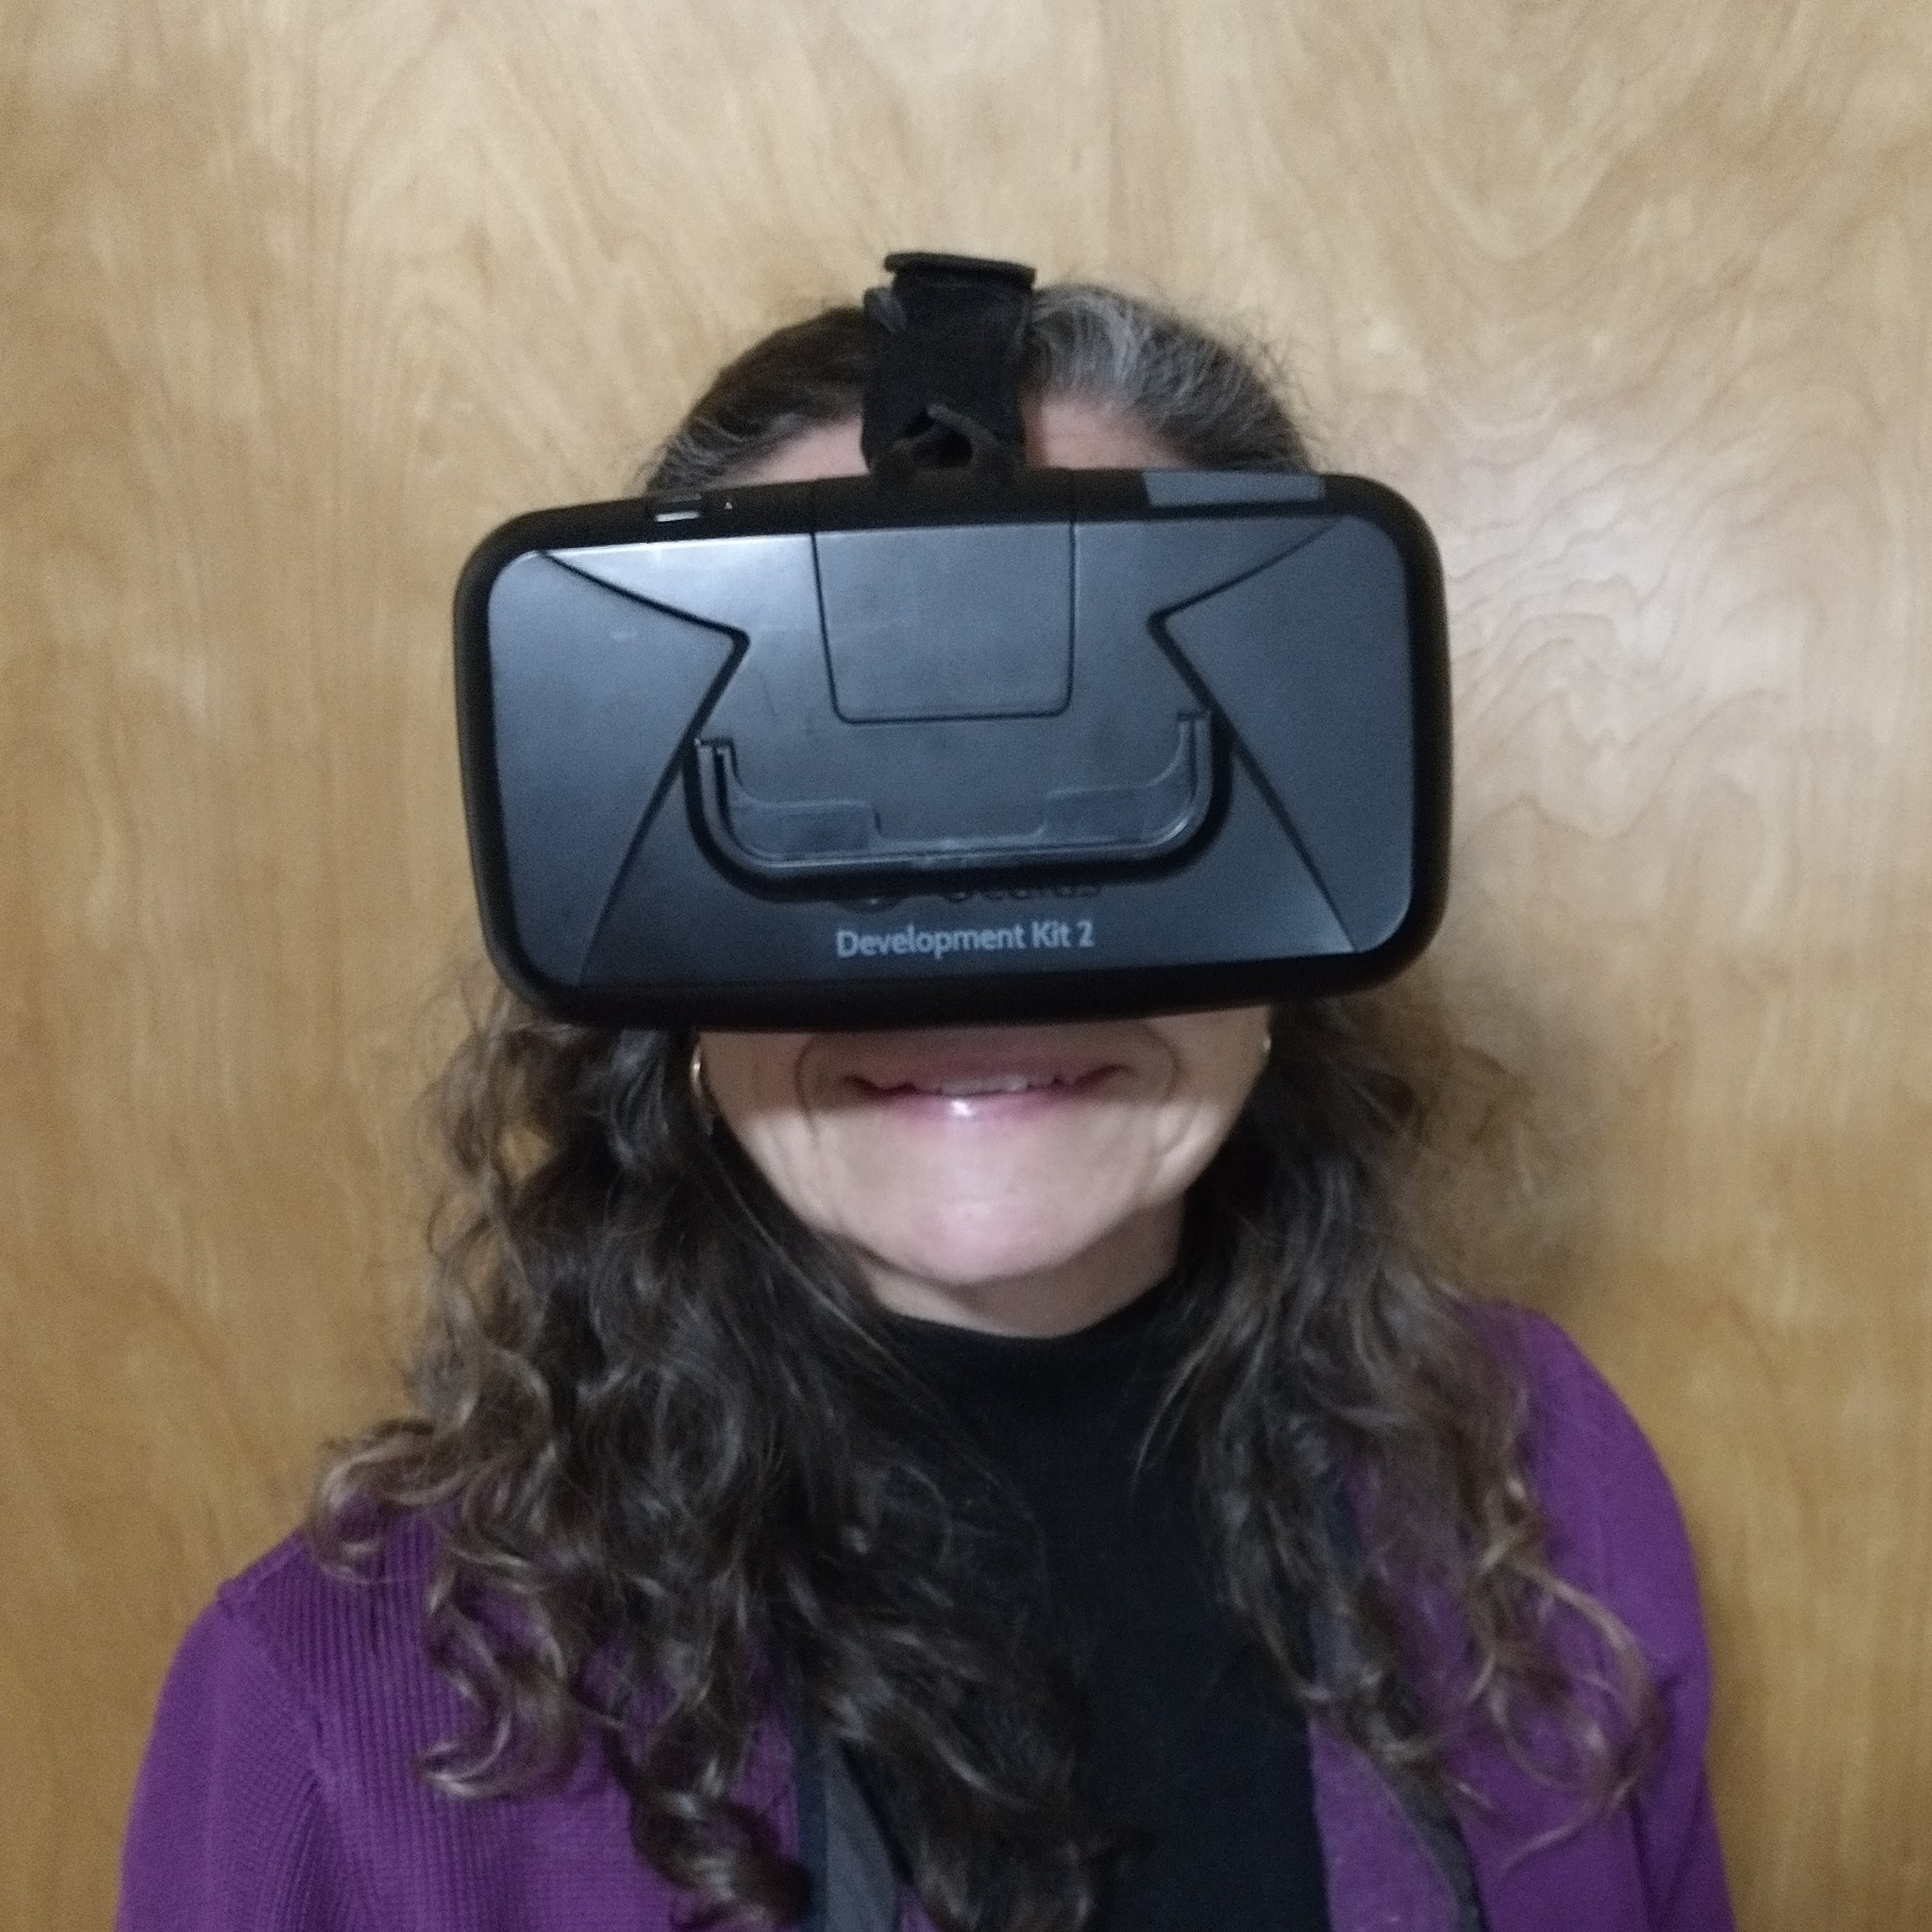
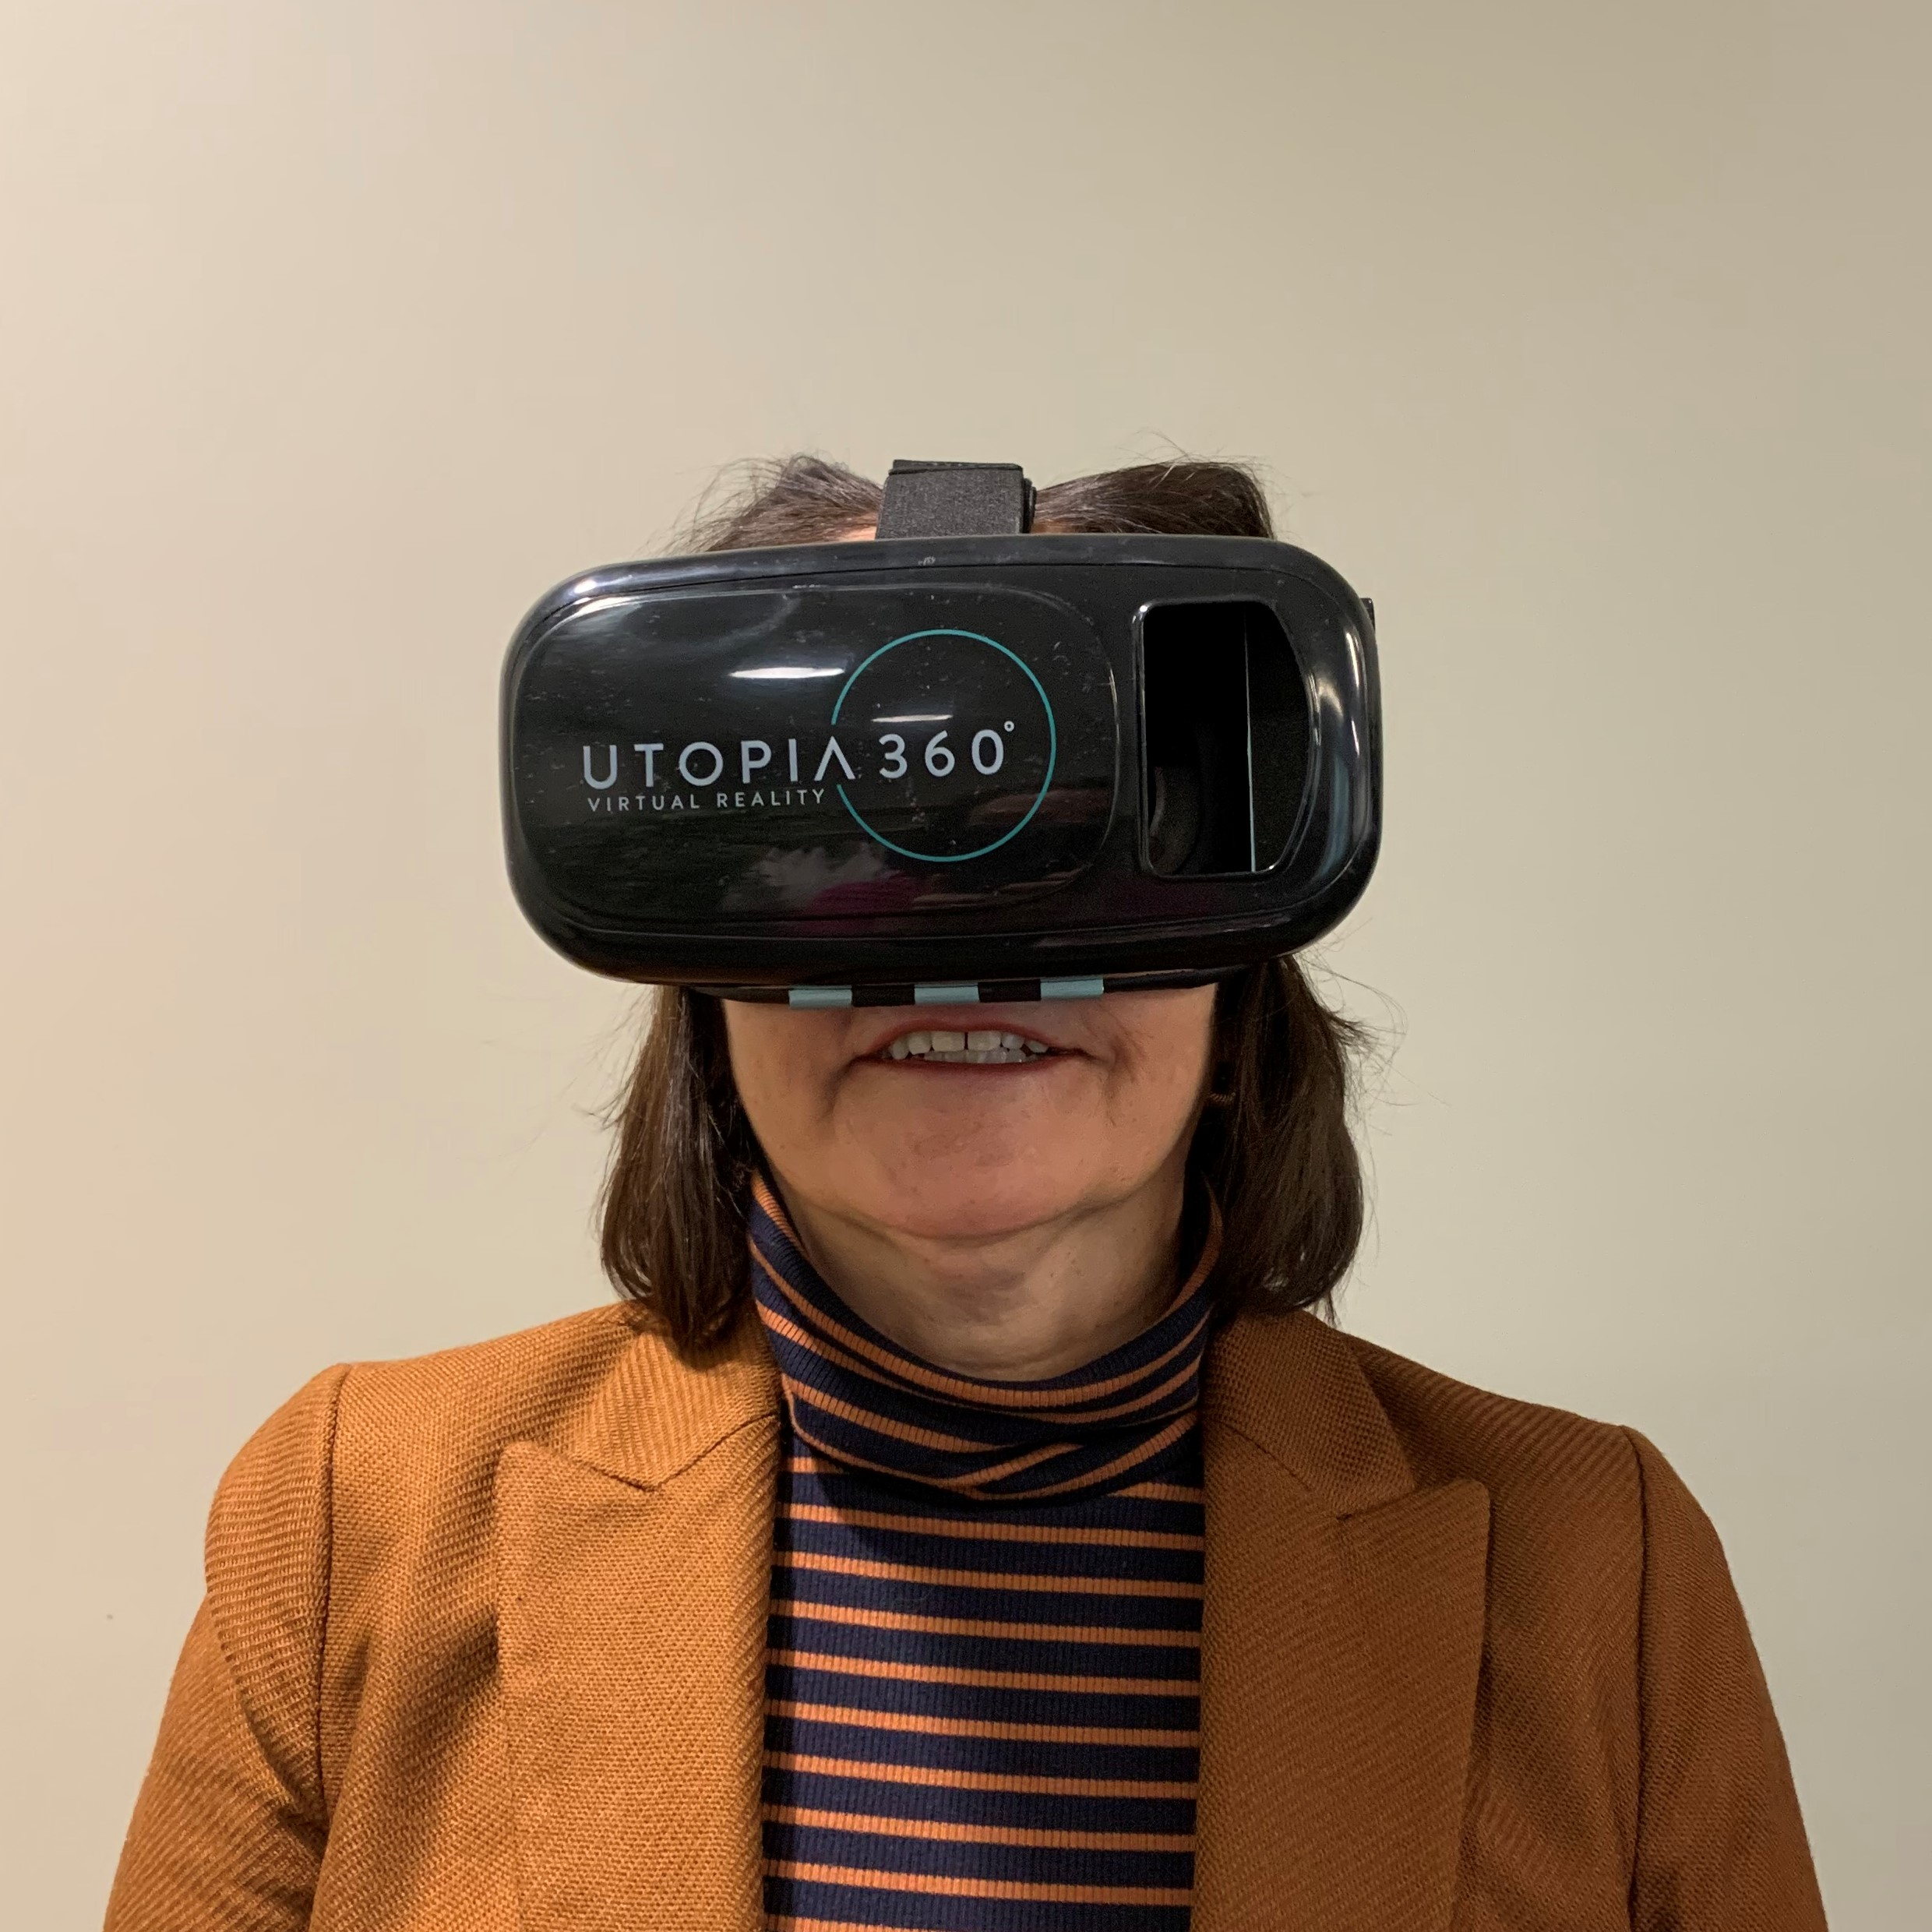
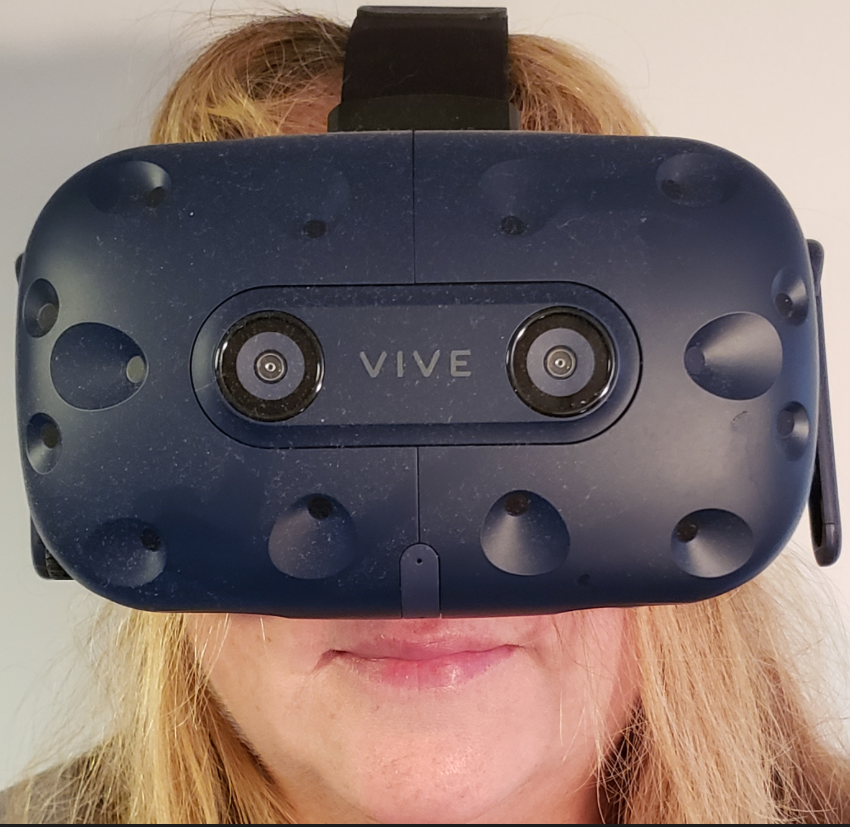
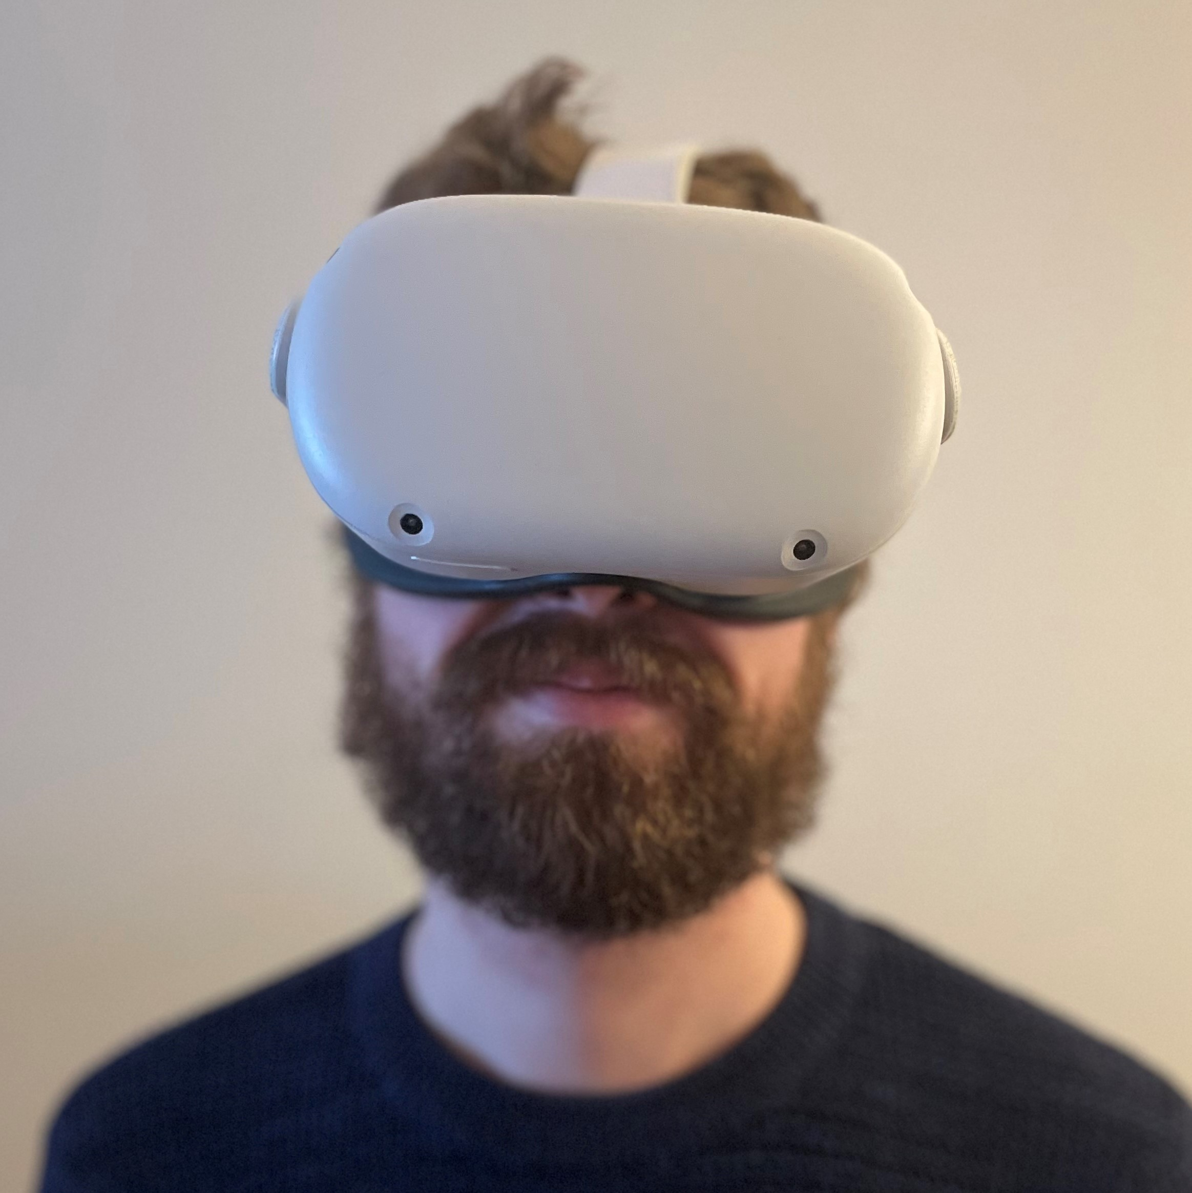
Contact us
Melissa Fischer, MD MEd
Melissa.Fischer@umassmed.edu
Patty Lanzillotti
Patricia.Lanzillotti@umassmed.edu
Julie LeMoine
Julie.LeMoine@umassmed.edu
Matt Kersey
M.Kersey@columbia.edu

